Slide 1

Welcome!
Maximizing Your Five Capitals
Jay Pullins

Slide 2
Hi, I’m Jay
Leadership Coach- Academy Leadership
Leadership Coach- Five Capitals
Retired Air Force Officer
Former Executive Pastor
Former Chief of Staff - Alaska Lieutenant Governor
Former Special Assistant - Alaska Governor

Slide 3
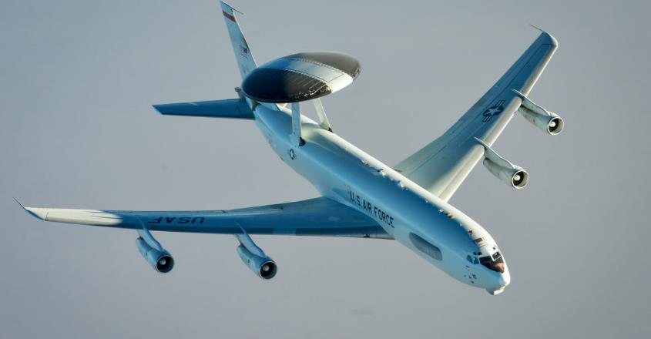

Slide 4
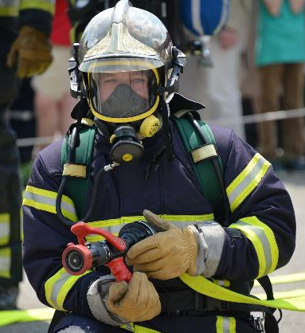
Overview
Four Tools for Integrated Leadership Effectiveness
Five Capitals
The Pareto Principle
The Tyranny of the Urgent
The Primacy of Planning

Slide 5
Leadership Effectiveness
Empowering Others to Achieve Their Best Results in Support of Collective Goals
Integrated: Applicable at Work and Home

Slide 6
What Are Our Five Capitals?
Financial Capital
Intellectual Capital
Physical Capital
Relational Capital
Character Capital
The Resources That Leaders Leverage (Grow and Spend) to Achieve Goals

Slide 7
Financial Capital
The Financial Resources We Leverage (Grow and Spend) to Achieve Goals

Slide 8
Intellectual Capital
The Knowledge, Experience, Expertise, Creativity, Education and Insight We Leverage (Grow and Spend) to Achieve Goals

Slide 9
Physical Capital
The Physical Abilities We Leverage (Grow and Spend) to Achieve Goals
Health
Strength/Energy
Time
Location
Your “Stuff”

Slide 10
Relational Capital
The Relational Equity or Trust That We Leverage to Achieve Goals
Measured in Influence and Impact in the Lives of Others

Slide 11
Character Capital
The Moral & Ethical Authority, Integrity and Reputation That We Leverage (Grow and Spend) to Achieve Goals

Slide 12
Character VS Competence
High Character
Low
Competence
High
Competence
Low Character

Slide 13
Character VS Competence
High Character
Max Potential for Success
Low
Competence
High
Competence
Low Character

Slide 14
Character VS Competence
High Character
Limited Potential for Success
Max Potential for Success
Low
Competence
High
Competence
Low Character

Slide 15
Character VS Competence
High Character
Limited Potential for Success
Max Potential for Success
Limited Potential for Harm
Low
Competence
High
Competence
Low Character

Slide 16
Character VS Competence
High Character
Limited Potential for Success
Max Potential for Success
Limited Potential for Harm
Max Potential for Harm
Low
Competence
High
Competence
Low Character

Slide 17
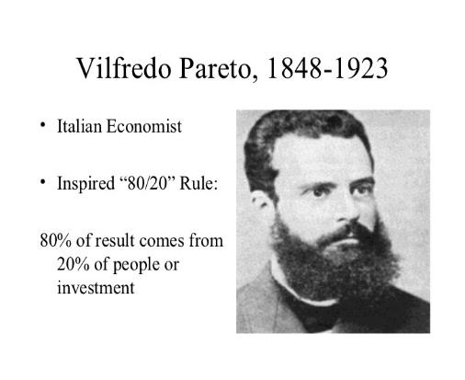
Pareto Principle

Slide 18
High Payoff Activities
The 20% of your tasks that yield 80% of your results

Slide 19
What are Your High Payoff Activities?
Ask Yourself:
What Tasks Can Only Be Done By You?
How would Your Supervisor Describe Your Responsibilities?
Why Were You Selected For This Role?
What Tasks Sustain Long-Term Success?
What Tasks Make Others More Effective?

Slide 20
Tyranny of the Urgent
1. Urgent and Important
2. Important,
Not Urgent
3. Urgent,
Not Important
4. Not Urgent,
Not Important
Tasks

Slide 21
The Primacy of Planning
Every minute spent planning saves six minutes in execution.
Planning is your #1 High Payoff Activity
Monday-Thursday: Last 15 minutes of the day
Friday: Last 90 minutes of the day
Notes:
David Allen – Getting Things Done
Tim Ferriss – The Four-Hour Work Week

Slide 22
Do the Math
150 minutes per week spent planning recovers 15 hours per week in execution time.
1,000 employees recovering only 10 minutes per day in mindless busyness recovers $5 Million per year in improved productivity.

Slide 23
Two Things To Remember
Pareto Principle: 20% of your Effort Yields 80% of your Results
Planning is your Highest Payoff, Time Saving Task

Slide 24
Two Things To Do
Discover Your High Payoff Activities
Get Them On Your Calendar

Slide 25
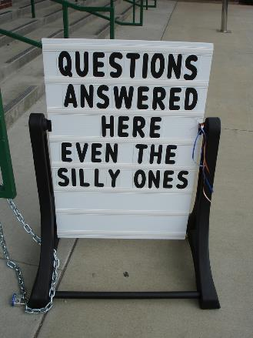
Questions?
Ideas?
Thoughts?
Stories?

Slide 26
Thanks For Listening!
AcademyLeadership.Com
FiveCapitals.Net
(907) 244-3369
jpullins @academyleadership.com
FREE Consultation
Want to Know More About
Leadership Development Programs
and
Executive Coaching?

