Slide 1


Managing in an
Uncertain Economy
Dr. Alan Beaulieu
President

Slide 2
2018 Preliminary Forecast Results
If you heard ITR around two years prior…
2
 | Duration | Accuracy
US GDP | 24 | 99.9%
US Ind. Production | 34 | 99.4%
Europe Ind. Production | 24 | 99.2%
Canada Ind. Production | 27 | 97.1%
China Ind. Production | 30 | 99.9%
Retail Sales | 28 | 99.6%
Housing (Single Family Units) | 26 | 99.2%
Employment (Private Sector) | 30 | 99.4%
ITR Economics provides the best economic intelligence to reduce
risk and drive practical and profitable business decisions.
Notes:
@@@ Updated March 6, 2019

Slide 3

Summary April 2019
Macroeconomic Softness in 2019
US
Global
Segment Thinking Into 3 Time Periods
2019 - 2020
2021 - 2029
2030 - 2040
Global Issues Impacting Our Businesses
Tariffs
Leading Indicator Signals are Mixed
Know which ones matter to you
How to track the leading indicators
Notes:
From Brian 3/19/18

Slide 4
Manage the Business Cycles to Maximize Profits
US Industrial Production to Gross Domestic Product
Year-over-Year, Quarter-to-Quarter (3/12)
Sources: FRB, BEA
Notes:
Tec Generic 1 FRBGDP3 4/1/19
Lines & Numbers Update
FRB & GDP

Slide 5
Slowing Growth for 2019
US Industrial Production Index
US Industrial Production Index
109.2
0.5%
C
0.7%
3.9%
2.0%
Source: FRB
Notes:
4/1/19 (Powerpoint Charts/ Misc Important charts/ USIP Charts from TD Report 4/1/19
Using Dec 2015 Prelim forecast

Slide 6
US Economy Stalls in 2019 and Into 2020
US Gross Domestic Product, SAAR, Chained 2012 $
US Gross Domestic Product
$18.8 trillion
0.9%
B
1.8%
3.1%
1.3%
Source: BEA
Notes:
@@@ 3/21/19 Forecast updated!! Brian TEC Generic 1 GDPCON Charts 3/21/2019

Slide 7
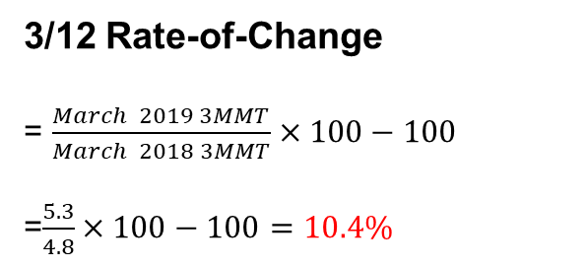

A Powerful Management Tool
Rate-of-Change
 | Raw
Apr-17 | 1.5
May-17 | 1.5
Jun-17 | 1.4
Jul-17 | 1.5
Aug-17 | 1.3
Sep-17 | 1.3
Oct-17 | 1.6
Nov-17 | 1.6
Dec-17 | 1.5
Jan-18 | 1.7
Feb-18 | 1.6
Mar-18 | 1.7
Apr-18 | 1.7
May-18 | 1.7
Jun-18 | 1.6
Jul-18 | 1.7
Aug-18 | 1.5
Sep-18 | 1.5
Oct-18 | 1.9
Nov-18 | 1.7
Dec-18 | 1.7
Jan-19 | 1.9
Feb-19 | 1.7
Mar-19 | 1.7
3MMT
4.4
4.4
4.4
4.2
4.1
4.2
4.5
4.7
4.8
4.8
5.0
5.0
5.1
5.0
5.0
4.8
4.7
4.9
5.1
5.3
5.3
5.3
3/12
15.9%
13.6%
13.6%
14.3%
14.6%
16.7%
13.3%
12.8%
10.4%
10.4%
12MMT
18.0
18.2
18.4
18.6
18.8
19.0
19.2
19.4
19.7
19.8
20.0
20.2
20.3
12/12
26.7%
25.5%
25.2%
22.4%
20.0%
18.3%
15.4%
12.7%
3/12 Rate-of-Change
= $\frac{March 2019 3MMT}{March 2018 3MMT}×100−100$
=$\frac{5.3}{4.8}×100−100=10.4\%$
DATACAST !
12/12 Rate-of-Change
= $\frac{March 2019 12MMT}{March 2018 12MMT}×100−100$
=$\frac{20.3}{18.0}×100−100=12.7\%$
Notes:
Update it Monthly! TEC Generic 4 DATA PREP
April 2019

Slide 8
Rate-of-Change – A Management Tool
Notes:
PowerPoint Charts/Charts Reserve/SOC 11 Charts TRUCKH ANIMATE 2/26/19

Slide 9
The Macro Outlook Says Downward Pressure in 2019
US Industrial Production to Paperboard Containers Production
12/12 Rates-of-Change
Source: FRB
Notes:
R:\PowerPoint Charts\Charts - Reserve\FRB 3 Charts FRBPPRCTNX 4/1/19

Slide 10
A Difficult 2019 for Producers
Paperboard Containers Production Index
32221 Paperboard Container Manufacturing
This industry comprises establishments primarily engaged in converting paperboard into containers without
manufacturing paperboard. These establishments use corrugating, cutting, and shaping machinery to form
paperboard into containers. Products made by these establishments include boxes, corrugated sheets, pads,
pallets, paper dishes, and fiber drums, and reels.
Lowest 3/12 in 3 years
12MMA slipping lower off Oct ‘18 high
2012 = 100
Source: FRB
Notes:
R:/PowerPoint Charts/Charts Reserve/SOC 9 Charts PPRCTNX 4/1/19

Slide 11
More Cyclical Decline Ahead
11
US Industrial Production to US Wholesale Trade Nondurable Goods
Rapid deceleration
12MMA flat at record high $
12/12 Rates-of-Change
Sources: FRB, US Census Bureau
Notes:
R:\PowerPoint Charts\Charts - Reserve\FRB 7 Charts FRBWTNDUR 4/1/19

Slide 12
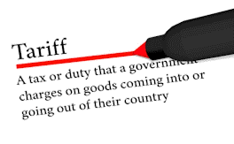
Tariffs and other
fun things

Slide 13
Things Are Getting Better
World Carbon Dioxide Emissions
Millions of Metric Tons
Source: EIA
Notes:
Tec G 4 WorldCO2 Chart 1/7/19 Annual Data

Slide 14
Manufacturing: A Growing Part of America
US Industrial Production Index to US Total Manufacturing Production Index
12/12 2.9% Fastest growth in 6 yrs
3/12 3.0% Sep ‘18 high
12MMA 1.8% < Feb ‘08 record high
Annual Data Trends
Source: FRB
Notes:
Charts-Reserve/FRB 17 Charts FRBTMANUNSADT-L 4/1/19

Slide 15
Widening Trade Imbalance with China
US Trade with China: Imports to Exports
Imports from China
3/12 2.8% C, lowest in 21 months
12MMA flat with October 2018
record high
Deficit Reduction
Enforcement
Intellectual Property
Currency
What happens to existing tariffs
Exports to China
3/12 -31.5%, lowest in 28 yrs
12MMA -11.1% off July 2018
record high
Annual Data Trends
Source: US Census Bureau
Notes:
@@ W:ITRDATA/PowerPoint Charts/Charts – Reserve/Mixed Bag 4 Charts USEXPCHN USIMPCHN 4/1/19

Slide 16
Issues Government Will and Won’t Tackle
US Federal Government Receipts and Payments
Billions of Dollars
Source: BEA
Notes:
Charts-Special\Federal Government receipts and payments.xlsx All to Interest Payments 3/6/2019 (Quarterly, same schedule as GDP)

Slide 17
Who Owns the US National Debt
Sources: MarketWatch, US Treasury
Notes:
Charts-Special\Foreign Holders of US Debt Pie 2/22/19

Slide 18
Concentrated Foreign Ownership of US Debt
Top Foreign Owners of US National Debt
As of December 2018
Source: US Treasury
Notes:
Charts-Special\Foreign Holders of US Debt Bar 2/22/19

Slide 19

The Long View
Prosperity in the
Age of Decline

Slide 20
A Model for the Future
US Industrial Production Index
Data Trends
Source: FRB
Notes:
Misc Important Charts\TIPROHNSA Comps Data Trends Does not Update

Slide 21

Global Partners

Slide 22
Global Weakness is Indicated
Global Leading Indicators
1/12 Rates-of-Change
Source: Markit Economics
Notes:
NEW Charts – Reserve/Europe 4 Charts/ Global LI (3) 3/6/2019

Slide 23
Trade Stress Becomes Acute on the Downside of the Cycle
World Industrial Production Index to G7 Leading Indicator
Rates-of-Change
Sources: CPB Netherlands Bureau For Economic Policy Analysis, OECD
Notes:
Misc Important Charts/TIPUTL112-Brian WORLDIP G7LI 1.12 4/1/19

Slide 24
A Downward Signal from the World IP
US Industrial Production Index to World Industrial Production Index
Rates-of-Change
Sources: FRB, CEIC
Notes:
W:\ITRDATA\Forecast Comp Charts\TIPRONSA Comps WORLDIP 1.12 4/1/19

Slide 25

The US Economy

Slide 26
Leading Indicator System as a Powerful Tool
US Industrial Production Index to Leading Indicators
Rates-of-Change
Sources: FRB, OECD, ISM, Yahoo Finance, IHS Markit
Notes:
Charts-Special/Connor TIPRONSA Comps PMI 1.12 (2) 4/1/19 **For Alan, with DOMESTIC Corporate Profits
Animation: Wipe from left. First 4 WITH PREVIOUS, .5 SECS. 5th: On-Click, 2 SECS. The rest: On-Click, 1 SEC
**Domestic Corp Profits is temporarily removed from this chart. The data is still selected, it's just unchecked in the data selection box. When they want to add it back in, just re-check the box. Then re-paste the chart into the slide and add animation. ***And re-add BEA in the sources!

Slide 27
ITR’s Leading Indicator™ Says Problems Ahead
US Industrial Production to ITR Leading Indicator™
Reported in ITR Trends Report – ITR Advisor
USIP – 12/12 Indicator - Monthly
Sources: FRB, ITR Economics
Notes:
R:\PowerPoint Charts\Charts - Reserve\FRB 13 Charts 4/1/19 FRBITRLI NO ANIMATION FOR BRIAN
Animation: Orange line moves (keep series 2 only)

Slide 28
Downside Business Cycle Pressure in 2019
US Paperboard Containers Production Index to ITR Leading Indicator™
Rates-of-Change
Sources: FRB, ITR Economics
Notes:
W:ITRDATA/PowerPoint Charts/Charts – Reserve/Mixed Bag 7 charts PPRCTNX ITRLI 4/1/19

Slide 29
US Purchasing Managers Index Says More Downward Pressure on US Paperboard Containers Production
Rates-of-Change
Sources: FRB, Institute for Supply Management
Notes:
PowerPoint Presentations/Company/PPC/data/PPRCNTX for PPC.xlsm PMI 1.12 4/1/19

Slide 30
A Macro Economic Slowdown is Indicated
US Industrial Production to US Total Industry Capacity Utilization Rate
Rates-of-Change
Source: FRB
Notes:
Misc Important Charts/TIPUTL112 TIPUTL l.12 4/1/19

Slide 31

Further Decline Indicated
US Single Unit Housing Starts
As seen in
Mild decline in 2019
Million of Units
Source: US Census Bureau
Notes:
Tec Generic 3 HS2FAM 4/1/19

Slide 32
Decelerating CAPEX Trend
US Nondefense Capital Goods New Orders w/o Aircraft
12MMT rise to 1Q19
2018 1.3%
Billions of Dollars
Source: Census Bureau
Notes:
TEC Generic 2 NDFCGXA 3/21/2019

Slide 33
Slower CAPEX Spending in 2019
US Nondefense Capital Goods New Orders (excluding aircraft) to
US Machinery Manufacturing Capacity Utilization Rate
Rates-of-Change
Sources: Census Bureau, FRB
Notes:
******Misc Important Charts/NDFCGXA Comps MACHUTL.xlsx MACHUTL 1.12 2/26/2019

Slide 34
Optimism Index Portends a Softer 2019
US Nondefense Capital Goods New Orders
(excluding aircraft) to Small Business Optimism Index
12/12 Rates-of-change
Sources: US Census Bureau, NFIB
Notes:
W:ITRDATA/PowerPoint Charts/Charts – Reserve/Varied 17 Charts NDFCGXA SBOPTIM 3/22/2019

Slide 35
Copper is Signaling a Slowdown in Spending This Year
US Copper Futures Prices to
US Nondefense Capital Goods New Orders(excluding aircraft)
12/12 Rates-of-Change
Sources: WSJ, Census Bureau
Notes:
PPT Charts/Charts-Reserve/Misc 4 Charts COPFC NDFCGXA 4/1/19

Slide 36
US Nondefense Capital Goods New Orders without Aircraft Says More Downward Pressure on US Paperboard Containers Production Index
12/12 Rates-of-Change
Sources: FRB, Census Bureau
Notes:
PowerPoint Presentations/Company/PPC/data/PPRCNTX for PPC.xlsm NDFCGXA 3/21/2019

Slide 37

People

Slide 38
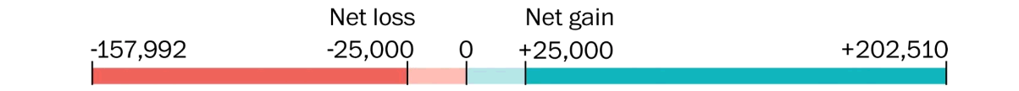

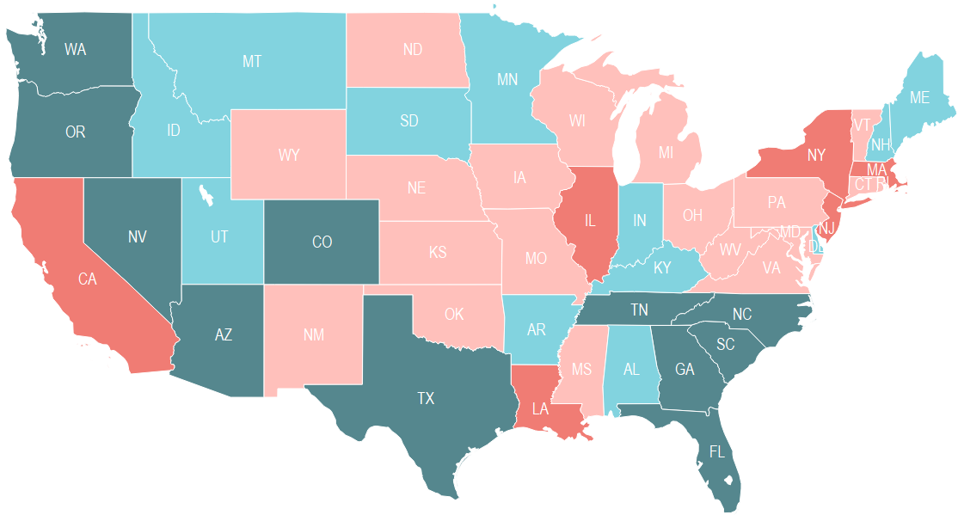
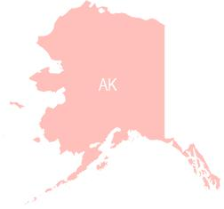

Net Migration Between States, July 2017-July 2018
-180,306
+132,602
Does not include immigration into the US
Source: Census Bureau
Notes:
2/18/19 HF PowerPoint Charts\Maps\Net State Migration Map.xlsx Updates annually Feb/Mar
Data from Census Bureau: https://www.census.gov/data/tables/time-series/demo/popest/2010s-national-total.html
Find latest annual file (probably named NST-EST[year]-05.xlsx
Download and paste new data over old data (make sure file format and number of cells are the same)
Column I is a formula – don’t change it
Save
Open the map file through Tableau and update the maps
Paste maps onto slide
Update right and left notations on the legend (on the slide)
The left side is the number from cell M2 in the excel file
The right side number is from cell M3 in the excel file

Slide 39
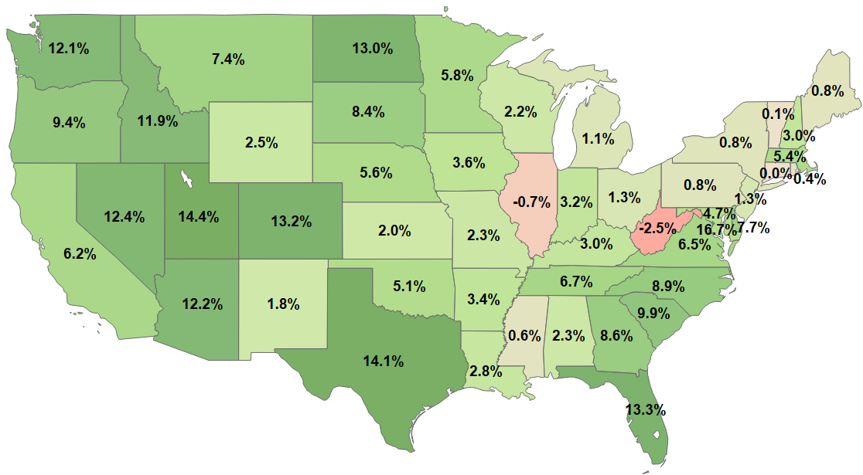
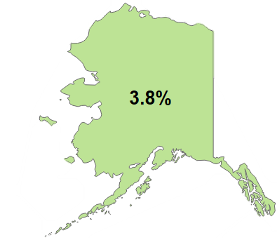
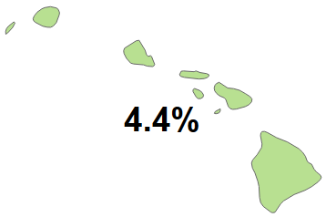

State Population Growth Rates
Percent Change from Population Estimates 2010 to 2018
Source: US Census Bureau
Notes:
2/15/19
PowerPoint Charts/Maps/State Population Growth Rates

Slide 40
On the Backside of the Business Cycle
US Total Retail Sales
Deflated: 12/12 2.2% C 3/12 0.8%
12MMT has leveled off
Slowing retail sales means slower growth in the economy at large
Trillions of Dollars
Source: Census Bureau
Notes:
Charts-Reserve/SOC 20 Charts.xlsx RS22 SOC 4/1/19

Slide 41
Lowest 3/12 value in 9 years
US E-Commerce Retail Sales
The sale of goods and services where the buyer places an order, or the price and terms of the sale are negotiated over an Electronic Data Interchange, the Internet, or any other online system (extranet, e-mail, instant messaging). Payment may or may not be made online.
$513.6bn is 8.5% of the total
Billions of Dollars
Source: Census Bureau
Notes:
R:\Powerpoint Charts\Charts – Reserve/Retail Sales 5 Charts ECOMMERCE SOC 3/21/2019

Slide 42
New ITR Leading Indicator Says Slowing Growth Ahead
US Total Retail Sales to ITR US Retail Sales Leading Indicator
Retail Sales = 12/12, ITR Retail Sales = Monthly
Sources: Census Bureau and ITR Economics
Notes:
ITRDATA/Forecast Comps/RS22Comps.xlsm ITRRSLI Monthly 4/1/19 Alan likes this one as of 8/14/18

Slide 43
Searching for a Recession
US Search Interest for "Recession" on Google to
US Total Retail Sales
Rates-of-Change (Search Interest has a 16 month lead time)
Sources: Google, US Census Bureau
Notes:
W:ITRDATA/PowerPoint Charts/Charts – Reserve/Motley 5 Charts GOOGRECSUS RS22 4/1/19

Slide 44
Slowing Consumer Spending in 2019
Total Retail Sales to US Health & Personal Care Retail Stores
12/12 Rates-of-Change
Source: US Census Bureau
Notes:
R:/PowerPoint/Charts-Reserve Charts/Retail Sales 2 Charts RS22 RSHPC 4/1/19

Slide 45
Decelerating Growth in Beverage Production
US Total Retail Sales to US Beverage Production Index
12/12 Rates-of-Change
Sources: US Census Bureau, US Bureau of Labor Statistics
Notes:
R:\PowerPoint Charts\Charts - Reserve\ Retail Sales 1 Charts RS22 BEVRGX 4/1/19

Slide 46
More Downside Pressure Ahead
US Total Retail Sales to US Sporting Goods Retail Stores
12/12 Rates-of-Change
Source: US Census Bureau
Notes:
R:/PowerPoint/Charts-Reserve Charts/Retail Sales 3 Charts RS22 RSSPORTS 4/1/19

Slide 47
Decelerating Growth in Consumer Spending
US Grocery Stores Retail Sales
Billions of Dollars
Source: US Census Bureau
Notes:
W:ITRDATA/PowerPoint Charts/Charts – Reserve/SOC 2 Charts RSGROC SOC 4/1/19

Slide 48
Wholesale Trade of Nondurable Goods to
US Consumer Nondurable Goods New Orders
Nov ‘17 high
12/12 Rates-of-Change
Notes:
PowerPoint Presentations/Company/PPC/Data folder/WTNDUR for PPC NONCON 4/1/19

Slide 49

Prices

Slide 50
Disinflation in 2019 = No Interest Rate Rise in 2019
US Consumer Price Index to US Producer Price Index
1/12 Rate-of-Change
Source: FRB
Notes:
TEC Generic 5 CPIUA PPI 1.12 3/21/2019

Slide 51
Pricing Pressures Set to Ease in 2019
US Paperboard Producer Price Index
1982 = 100
Source: Bureau of Labor Statistics
Notes:
W:ITRDATA/PowerPoint Charts/Charts – Reserve/SOC 17 Charts PPRBRDPI 3/21/2019

Slide 52
5 Pieces of Actionable Advice for Phase C
1. Develop your rates-of-change so you will know when the trough is near
(Use the ITR Checking Points™)
2. Focus on the segments of the business that are the most profitable in Phase C
3. Trumpet your Phase C competitive advantages and start developing your
message for the next phase (B or D, depending on your industry)
4. Cash Management for proper allocation and Inventory Control if applicable
5. Ask yourself what you shouldn’t be doing? (resource management and
diversion to more profitable parts of the company)

Slide 53










90 Day Trial Offer
Receive monthly updates on the economy
Text TR TRIAL to 444999
for a 90 day trial of our
Trends Report
@ITROutlook
Notes:
Not Vistage

Slide 54
Any Questions?

