Slide 1

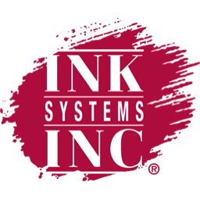
WHAT’S UNDER THE HOOD OF PROPOSITION 65 AND ITS UPDATES?
Lisa Fine – Ink Systems, Inc.
April 3, 2019

Slide 2
The Moral of the Story
The road to hell is paved with good intentions
[Derived from St Bernard of Clairvaux (1091 – 1153) “L'enfer est plein de bonnes volontés ou désirs »]

Slide 3
Proposition 65
Prop 65 requires that if a chemical causes “one excess case of cancer in 100,000 individuals exposed to the chemical over a 70-year lifetime,” there must be a warning label when that chemical is present. But since the warning label is not required to name all Proposition 65 substances present, it’s impossible for consumers to know whether there is a real risk or whether exposure levels are too low to pose any risk.

Slide 4
What Types of Substances Are on the Proposition 65 List???
Alcoholic beverages – cancer, developmental
Estrogen, testosterone – cancer
Metronidazole – cancer
Retinol/retinyl esters – developmental
Spironolactone – cancer
Warfarin – developmental
Zidovudine (AZT) – cancer
Acetaminophen – being considered! Cancer

Slide 5
Limits of Detection
Have improved substantially over the last decade for a number of analytical procedures
Is the presence of “any” analyte significant?
Conversely, is the failure to detect = none?

Slide 6
The concept of “any”
It is impossible to certify that there is “zero” amount of anything
Determining a “safe” limit is fraught with assumptions, both scientific and legal
Exposures are a factor when determining risk
Limits such as MADLs/NSRLs take into account other sources over which the supplier of the product has no control.

Slide 7
Safe Harbor Levels
Some substances on Prop 65 have allowable levels of exposure called Safe Harbor Levels that obviate the need for the product to carry a warning…BUT….
MADLs/NSRLs (Safe Harbor Levels) are defined in terms of micrograms per day of exposure by an individual.
There is no easy way to translate x ppm of substance in a product to this metric!!!

Slide 8

Prop 65 – The Penalty for Noncompliance
Can be up to $2,500 per occurrence per day – this adds up quickly!

Slide 9
The Changes in Prop 65 That Went Into Effect on August 31, 2018….
…merely made a change in how the warning is worded…..
FROM THIS:
WARNING: This product contains chemicals known to the State of California to cause cancer and/or birth defects or other reproductive harm.

Slide 10
TO THIS:
WARNING: This product contains benzophenone, a chemical known to the State of California to cause cancer, and toluene, a chemical known to the State of California to cause birth defects or other reproductive harm. For more information, go to www.P65warnings.ca.gov

Slide 11
The Purposes of the Change
To attempt to stem the tide of litigation and make the law less susceptible to the widespread abuses by plaintiff’s lawyers – in an effort to improve matters for those who do business in California
To make the warnings more useful to Californians by listing actual substances
To reduce the trend towards “over warning”, which dilutes the utility of the law (no penalty in providing a warning when one is not needed).

Slide 12
But Did This Help????
Between 8/1/2018 and 12/31/2018, there were 918 Sixty (60) Day Notices of Violation filed!
Why so many…..??????

Slide 13
Statute Leads to Abuses Not Originally Intended….
Individuals and legal firms have set up a cottage industry to pursue companies for Proposition 65 violations.
The rub is that the plaintiff does not have to prove that they are affected by – nor do they need to have a direct interest in - the products in question!!!!
Successful plaintiffs get their attorney fees reimbursed by the defendants as well!

Slide 14
The Big Bounty Hunters – Plaintiffs - Corporations
Ecological Alliance, LLC (157)
Consumer Advocacy Group, Inc. (127)
Consumer Protection Group, LLC (44)
Center For Advanced Public Awareness, Inc. (38)
Environmental Research Center, Inc (40)
Shefa LMV, Inc (37)
Center For Environmental Health (21)
Safer Products For Californians, LLC (16)

Slide 15
Who ARE These Corporations?
Many are just fronts for opportunistic individuals – no actual websites or product
Searching their names brings up all the lawsuits filed against California corporations as a primary result
Business locations are often private residences with no actual employees
Principals are often involved in unrelated businesses – Prop 65 bounty hunting is a side gig

Slide 16
The Big Bounty Hunters - Individuals
Anthony Ferreiro, Gabriel Espinosa, Ema Bell, Precila Balabbo – through one attorney, account for 170 filings in the period 8/1/2018 – 12/31/2018!!!
Kim Embry (46)
Laurence Vinocur (45)
Kingpun Cheng (36)
Amy Chamberlin (21)
Susan Davia (15)
Sara Hammond (13)

Slide 17
The Big Bounty Hunters – Their Attorneys
Custodio & Dubey, LLP (157)
Evan J. Smith, Esq. (170)
Yeroushalmi & Yeroushalmi (127)
Clifford A. Chanler (42)
Jonathan M. Genish (44)
Parker A. Smith (36)
Glick Law Group (28)
Daniel N. Greenbaum, Esq. (37)
Kawahito Law Group APC (26)

Slide 18
A Lucrative Endeavor!
The attorneys are caught up in the fervor, due to the fact that there are millions of dollars to be made
Specifically, Chanler and Greenbaum duking it out over benzophenone claims
In total, 2710 NOV were sent to business owners in 2017 – attorney fee provisions have much to do with that trend
2017 – 688 judgments or settlements were reached, totaling $25MM+, of which $19MM+ was paid to the attorneys!

Slide 19
Bounty Hunters – Why They Win
The burden of proof here is on the defendant to prove that they are not in violation or if they do have a substance, that it is at a safe level – a tough and expensive road! (safe harbor limits do not translate to actual concentrations!)……..
Plaintiffs and their attorneys know it, and monetary settlements are frequent as a result…….
Bounty hunter gets 25% of the penalties; attorneys get their expenses paid for minimal work. The State of California (specifically, OEHHA) gets 75% of the settlement/judgment penalties….meaning…..

Slide 20

Everyone Wins! Except…..
The business owner and its employees
The citizens of the State of California, whose court systems are overwhelmed with Proposition 65 cases miring up the works!!!

Slide 21
Low Hanging Fruit….
Consumer products
Cosmetics (especially Cocamide DEA and benzophenone)
Facilities
Supplements
Easy for a citizen to make a claim without having to do much research or testing….

Slide 22
Package Printing
Many Prop 65 substances have the potential to evaporate quickly or change their chemical identity during printing, and therefore may no longer be resident in the dried or cured ink: toluene, benzophenone are two examples
Exceptions – D & C Red #9 from barium-based pigments in PANTONE Warm Red, glycol ethers from fountain solutions, lead and cadmium residues in metallic pigments

Slide 23
A Standard of Reasonableness is Sorely Needed!
Acrylamide – found in roasted coffee beans, potato chips, the browning on baked goods and toast…
……yes, at some level it may cause cancer…..
BUT AT LEVELS FAR ABOVE WHAT ONE IS EVER LIKELY TO CONSUME AT THEIR LOCAL STARBUCKS SHOP!!!!

Slide 24
Starbucks
* Though it should be noted that FDA is in discussions with the State of California (OEHHA) to remove coffee itself from the clutches of Prop 65 reporting….

Slide 25
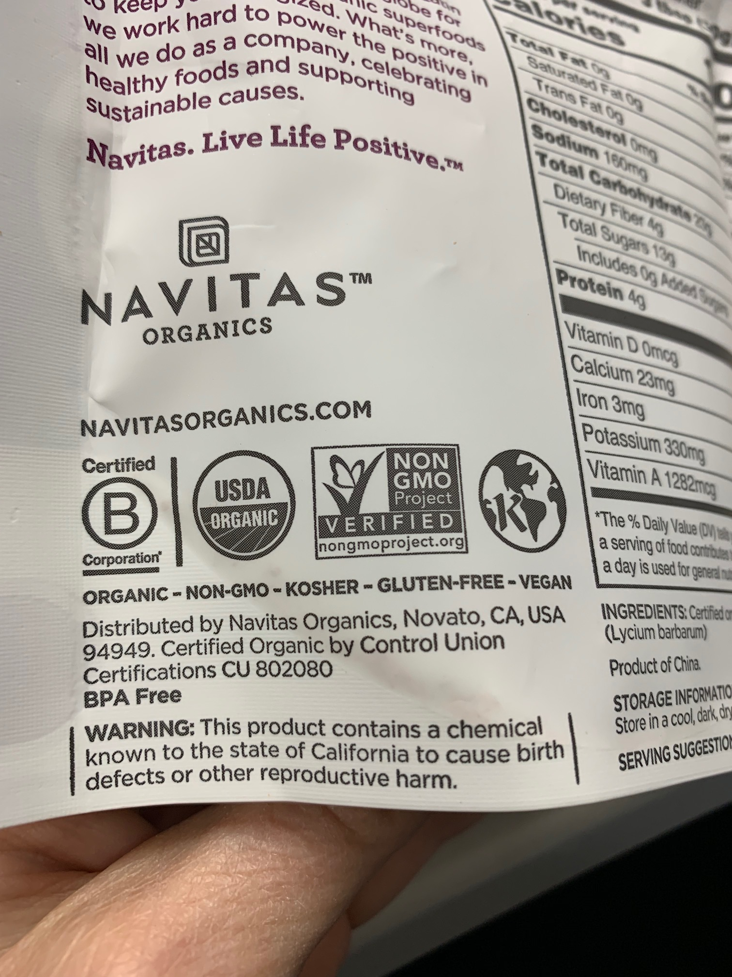
My morning snack….
* Is it something in the packaging or in the goji berries themselves….???

Slide 26
Food Packaging Gets “Real”

Slide 27

Prop 65 Compliance:
Does not mean that all listed substances must be removed from a product!
It merely requires that proper labelling must be on the product if Prop 65 substances are present
The presence of a listed substance does NOT mean the product is hazardous under the conditions of use or consumption
Most folks do not understand this
The choice to remove Prop 65 substances is at the discretion of the print buyer or brand owner
However, the product may not be able to be produced without them!

Slide 28

What Can the Printer Do?
Fortunately, packaging is not the “low hanging fruit” of the bounty hunters
Despite this, we are vulnerable due to the fact that anyone can bring a claim – disgruntled ex-employee, e.g.?
Make sure your facilities have the proper up to date signage at entrances if you reside in CA.
Talk to your vendors (not just the ink folks: those that supply fountain solution, roller cleaners, substrates, etc.) about the presence of Prop 65 materials and what could reasonably be expected to reside in the finished, printed product.

Slide 29
Where Does It End?
Governor Cuomo recently announced proposed legislation in New York for a Proposition 65 – like labeling program.
Unlike CA, no private plaintiff enforcement
Expect other states to follow suit

Slide 30
If You Only Remember Two Things From My Presentation, They Should Be….
Until and unless California revises the “private plaintiff” provisions, every company doing business in the state is vulnerable
Just because a substance is listed on Proposition 65 does NOT mean it is hazardous at all levels of exposure and conditions of use!

Slide 31
When You Get Back to Your Office, the Two Things You Should Do Are….
Work closely with your suppliers ASAP to understand all the substances you are introducing into the printed product, and which ones actually REMAIN with the product.
If you have a facility in California, make SURE you have the proper signage at entrances with the new language!

Slide 32
Questions?
Lisa Fine
Technical Director
INK SYSTEMS, INC.
614-327-4559
lfine@inksystems.com

Slide 33
Advanced formulations designed for the future.

