Slide 1



Slide 2



Slide 3



Slide 4
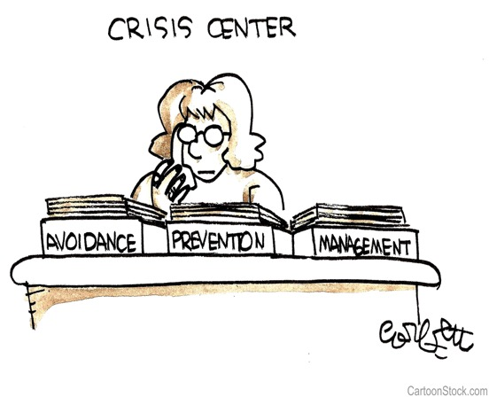
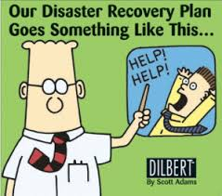
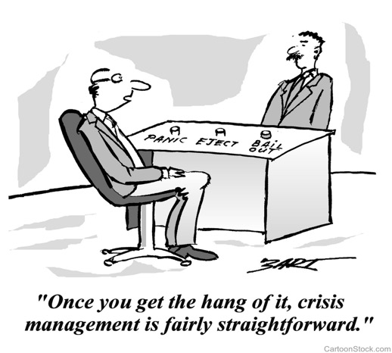
Does your crisis management look like this?
Pre-Crisis
During the Crisis
Post-Crisis

Slide 5
CRI*SIS/’krīsis/ - An unplanned event that triggers a real, perceived or possible threat to safety, health or the environment; or to the organization’s reputation or credibility.
An acute incident, critical event, or a series of cumulative incidents or circumstances which, if not handled in an appropriate manner, may dramatically impact an organization’s operations, profitability or reputation.

Slide 6
Three Key Things You Need to Know
About Crises
1. How your company reacts during the first seconds and minutes of an emergency will determine the success or failure of managing the crisis. The rule of thumb is to always be out front. By delivering the news instead of reacting to it, your organization can stay ahead of its own story.
2. How you manage the crisis will have a major impact on your organization’s reputation and larger, long-term future success.
3. Poorly handled crises damage personal and professional reputations, end careers and destroy companies.

Slide 7
12 Steps for Effective Crisis Response
1. Assess the situation, gather facts and notify key personnel
2. Convene the crisis communications team
3. Determine the “response scenario”
4. Develop the response plan
5. Notify key internal audiences by phone, text, fax, IM or email
6. Prepare materials and identify required resources

Slide 8
12 Steps for Effective Crisis Response (continued)
7. Identify and prepare spokespersons
8. Establish regular contact with key locations/managers
9. Release appropriate information
10. Monitor the issue
11. Review/evaluate effectiveness of response
12. Conduct post-crisis evaluation

Slide 9
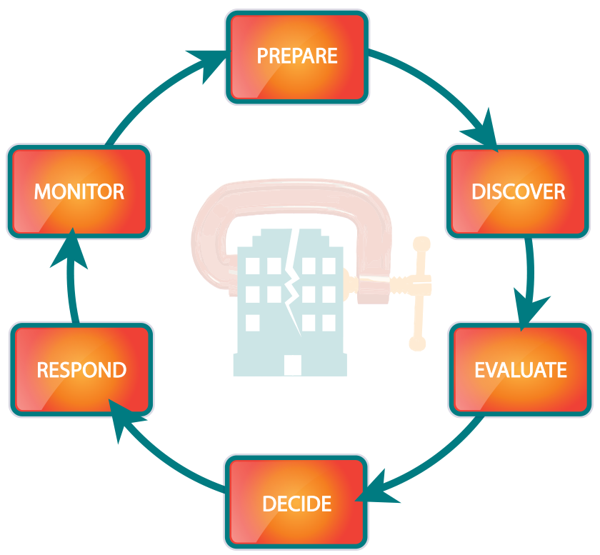

Slide 10

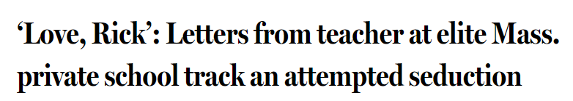
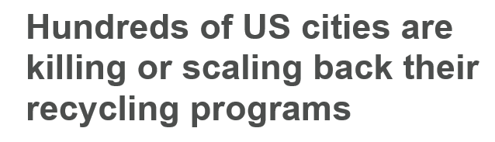
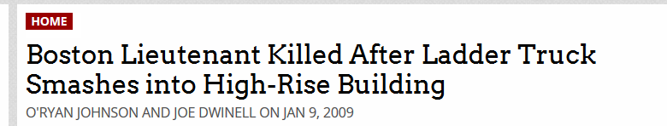

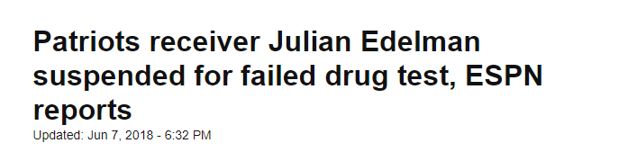
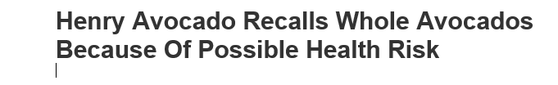
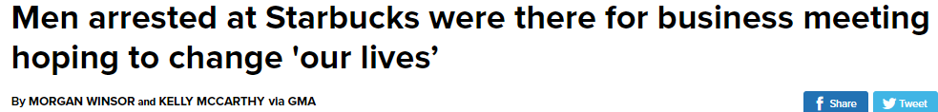

The Headlines Keep Coming…
Why Connecticut Is Collapsing
The state with the nation’s highest average income grapples with a huge debt problem even as young people and big employers — including Aetna — head for the exits.

Slide 11


DOVE SOAP – THREE SECONDS TO TARNISH A FAVORITE BRAND

Slide 12
AND SOMETIMES…..one image and a well-timed apology can stop a crisis in its tracks
Earlier this year, KFC in the UK had a huge product delivery problem. 900+ restaurants and NO CHICKEN!
Rather than blame DHL’s delivery service for the shortfall, here’s what they did in last Friday’s London Evening Standard that went viral. PR pros are calling it “the best apology ever…”

Slide 13


Slide 14

United Airlines Passenger Dragging

Slide 15

Today Show Open – Lauer Fired

Slide 16
Who’s on your Crisis Team?
CEO Legal Counsel IT
CFO Human Resources Communications/VP
COO Crisis Manager/Team Leader Public Relations
CMO Security Environmental/Health
Facilities Engineering Safety
Manufacturing Purchasing Sales/Marketing
Quality Control Other Division Managers Distribution
External Resources
AND…One Addition…the extremely annoying but highly qualified employee who makes your blood boil but is someone that you respect!

Slide 17
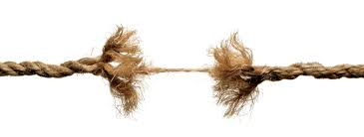
Types of Business Crises
Administrative
  Unauthorized or inappropriate spending
  C-Level Scandal
  Embezzlement/Executive under investigation
  Fraud
Workplace Tragedy
  Violence in workplace/shooting/disgruntled employee
  CEO Death or Serious Illness
  Serious accident
Environmental Accident
  Chemical Spill
  Truck overturns/explosion
Natural Disaster
  Fire, Blizzard, Hurricane, Flood, etc.
Product Recall
Data Breach/Cyber Crime
Advertising/Marketing Campaign Gone Wrong

Slide 18

Crisis Interception
Internal Approach
Fact Finding Team to identify details
Create Crisis Team based on specifics
External resources needed
Policy and Procedure (review/adjustments)
Guiding leadership to make the best decisions as expeditiously as possible
How to handle business as usual while dealing with the crisis
Human dynamics during crisis (playing nice in the sand box)
How do leaders show-up when all they want to do is bury their heads in the sand – executive decision making during a crisis
Company culture impact – rumor mill

Slide 19

Crisis Interception
External Approach
  Selecting the Crisis Team
  Worst case scenario identification
  Development of holding statements for anticipated scenarios
  Key questions to ask the team (fact finding)
  Spokesperson training and development
  Develop plan for information release – which media outlets when/order of priority? Press conference vs. telephone interviews, vs. statement only etc.
  Drill to test the efficacy of the plan
  Recap – how did we do and how can we get better

Slide 20
Preparing a Holding Statement
A holding statement is your first public response in a crisis situation
Express Concern/Empathy
Answer/Explain what happened as concisely as possible
using 4 of the 5 W’s (who, what, where, when – avoid the
why and how as that may take time to unfold)
What current actions are being taken?
When/How do you plan to update media?
Most important information top to bottom

Slide 21
Active Shooter Holding Statement
We are beyond devastated by today’s events and there are no words to adequately express the grief, pain and deep loss that we are experiencing today.
At 10:15 this morning, an active shooter entered our company headquarters on Boylston Street in downtown Boston. Four AMROC employees were killed, and three others were transported to the hospital with serious injuries.
Boston Police responded rapidly to contain the situation and I can report that the shooter is no longer a threat. Our thoughts and prayers are with everyone impacted by today’s terrible tragedy.

Slide 22
Active Shooter Holding Statement
(continued)
We are currently in the process of notifying our employees’ families. We will continue to work with law enforcement to get answers to the questions that so many of us are asking today and will update you as soon as we do.
We ask that you keep our employees, the victims and their families affected by today’s tragedy in your thoughts and hearts as we try to determine how and why this senseless act of violence occurred.

Slide 23
Three Things to Remember
How you act and react in the first few SECONDS and MINUTES of a crisis will determine the effectiveness of your response
Always be OUT FRONT even when you don’t want to be - DELIVER the news rather than REACT to it
It’s not IF…It’s WHEN

Slide 24
Three Things to Bring Back to the Office
Identify and form a company crisis team
Convene crisis team and brainstorm worst case scenarios and log by category
Prepare a holding statement for each crisis category

Slide 25
