Slide 1

Packaging in the 4th Dimension
Notes:
Passion for Packaging

Slide 2
Agenda
Introduction
Start with the End in Mind ‒ The Future of Packaging
2019 Trends and Predictions
What it Means for (Paperboard) Packaging
IIoT, Industry 4.0 Results
Key Takeaways

Slide 3
Agenda
Introduction
Start with the End in Mind ‒ The Future of Packaging
2019 Trends and Predictions
What it Means for (Paperboard) Packaging
IIoT, Industry 4.0 Results
Key Takeaways

Slide 4























The Twenty Five 2016 Program Sponsors
Notes:
Together, using foresight tools and insights
Cocreating the Future of Packaging

Slide 5









2019-2030 Sponsors: The Future of Packaging
Notes:
Welcome to sponsors across the VC and across categories and geographies

Slide 6
Foresight 2030
Global
STRETCH
SHAPE & CREATE Build a path forward: implications, strategies, actions for packaging
DEFINE Shape a view of how change could unfold for packaging
EXPLORE Stretch our thinking, ask “What if?’
Explore:
Alternative Scenarios
Explore:
Inquiry & Analysis
VIEW
Define: Connections back to present
Shape
Specific
Today
2025
2030 +
Notes:
In order to really get a good look at where we see things heading it is important to set a timeframe that is out there a bit and makes us a little bit uncomfortable.

Slide 7
Working Intentionally Towards Good VUCA
IPVM Maturity Model
Foresight based
Developed to project packaging needs for the future
Built using scenario planning, drivers, trends and Gartner Maturity Model
IPVM is early maturity and will continue to grow in importance and value
Bad VUCA Volatility Uncertainty Complexity Ambiguity
Good VUCA
Vision Understanding Clarity Agility
Foresight

Slide 8
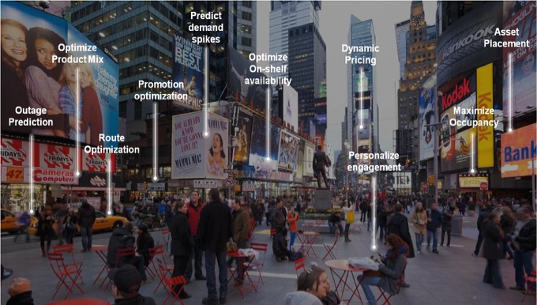




IoT = Digital Transformation
World’s largest accommodation provider…
owns no real estate
World’s largest taxi company…
owns no vehicles
World’s most valuable retailer…
has no inventory
World’s most popular media owner…
creates no content
Notes:
Define digital transformation – Digital and physical world come together
Some of the technologies that are driving transformation across all parts of businesses (cloud – computing anywhere, mobile – personalization / tracking, big data analytics & AI, IoT, VR / AR , 3D, digital printing, robotics
For college students today – its estimated that over 60% of the jobs they will see in their careers haven’t been invented yet

Slide 9
The 4th Dimension in Package Design
Notes:
ESL Smart Solutions has introduced SMARTpack which offers medication adherence monitoring. Fully integrated with EventMan Cloud, its asset tracking enables automatic invoicing and re-supplying as cells are opened.

Slide 10

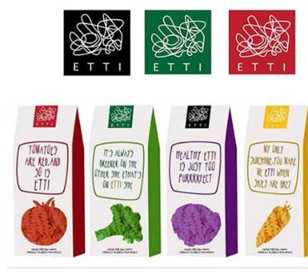
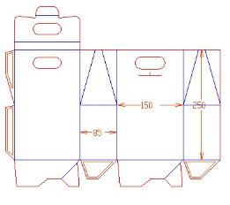
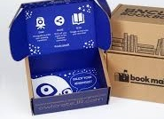
2D and 3D Design

Slide 11

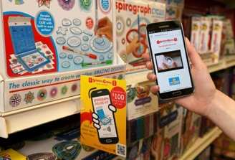
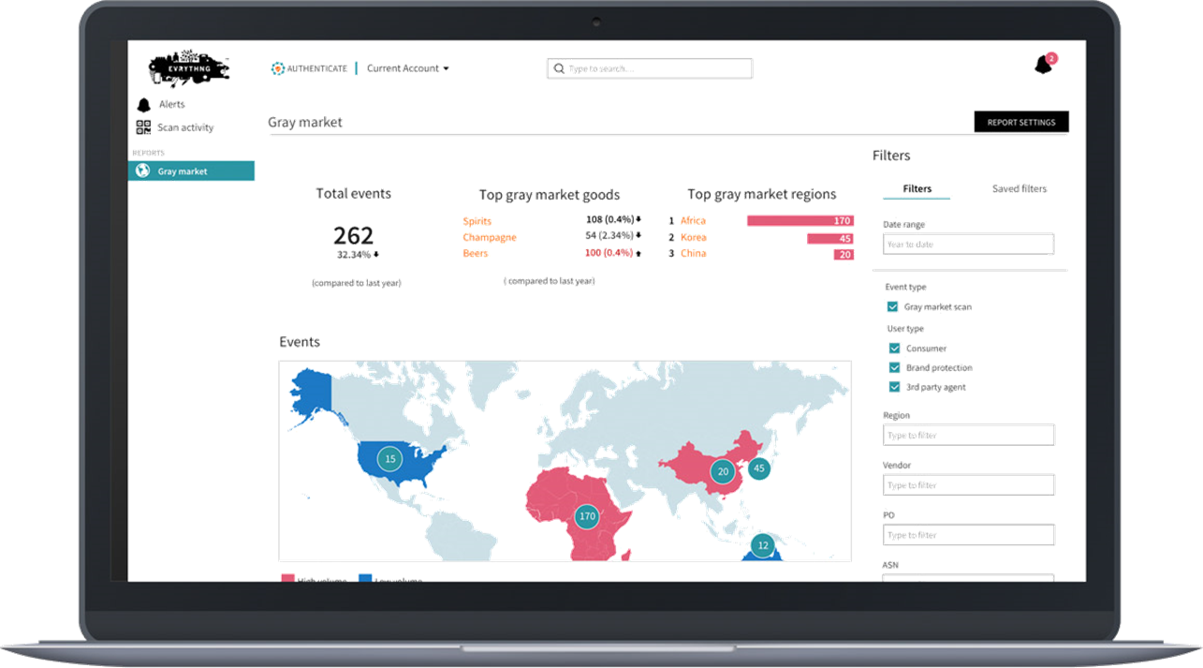
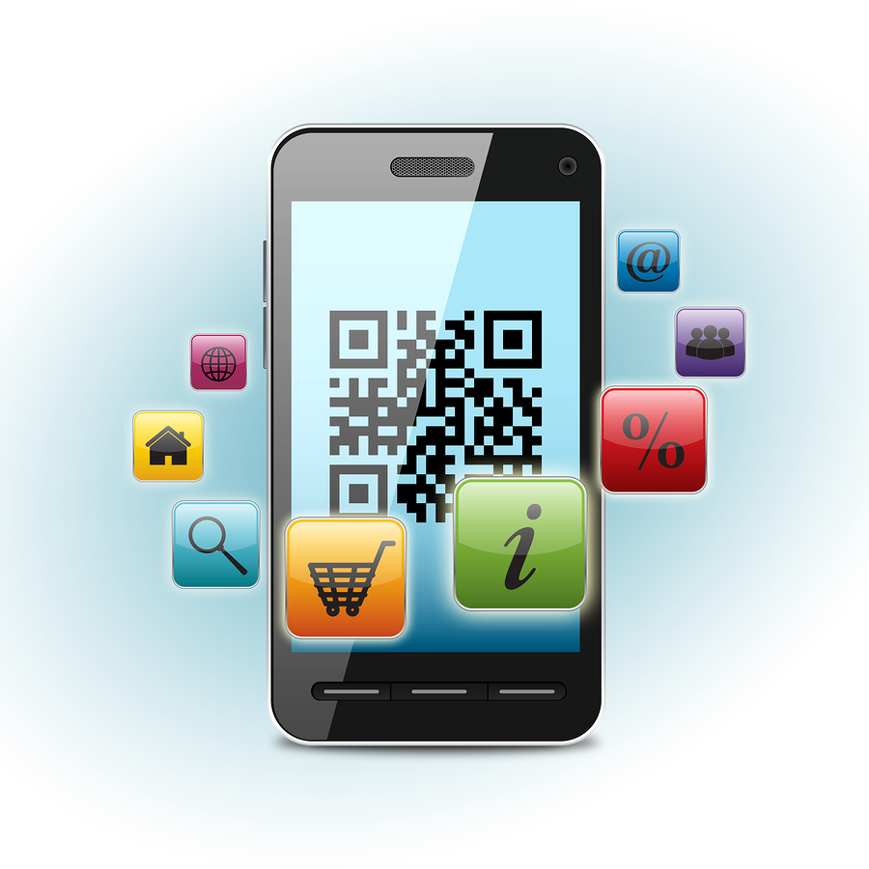
The 4th Dimension in Package Design
https://evrythng.com
Notes:
Internet of things driving digital transformation in our physical world
Exponential growth $50 billion devices by 2020, $2 trillion economic value
Connecting , capturing greater value across supply chains, operations and customer relationships
Building an ecosystem to build intelligence into every physical objects down to the item level to sense, analyze in real-time, and take best actions
Building an ecosystem to build intelligence into every physical objects down to the item level:
sense the world around them
analyze data in real-time to make the best decision
take the best actions
Capture greater value in many new ways: Predictive maintenance & forecasting , increased factory visibility & efficiencies, customer engagement & personalization
Avery Dennison, WestRock, Crown Holdings, ThinFilm, Digimarc
Diageo, Coca Cola, Mars, Unilever, Mondelez

Slide 12
https://evrythng.com

Slide 13
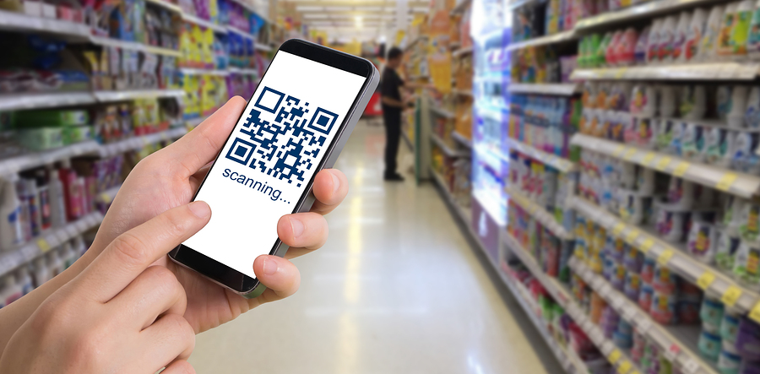
Enhancing the Consumer and Customer Journey

Slide 14
Agenda
Introduction
Start with the End in Mind ‒ The Future of Packaging
2019 Trends and Predictions
What it Means for (Paperboard) Packaging
IIoT, Industry 4.0 Results
Key Takeaways

Slide 15
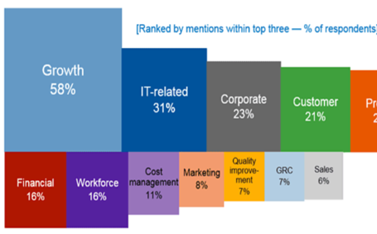
CEOs Top Priority: Digital Transformation
47% of CEOs challenged by BOD to make progress in digital business
56% said their digital improvements have already improved profits
Although many CEOs still mention e-commerce or digital marketing… more align to digital product and service innovation, Internet of Things, digital platforms, ecosystems."
GARTNER CEO TOP BUSINESS PRIORITY 2017-2018
Technology drives both growth and cost saving
Critical for competitive advantage for today and future
2017, 2018 Gartner Survey
Notes:
http://www.gartner.com/newsroom/id/3689017

Slide 16

CEO & CIOs Top Priority: Digital Transformation (2019)
DIGITAL INITIATIVES and growth are the two top business priorities for CIOs in 2019
Digital initiatives have passed the tipping point: 33% reported their digital efforts were now running for profit (either scaling or refining) vs. just 17% in 2018
89% of the top performers measure return on investment for digital activities
Top performers are 18 mos. to 2 years ahead of their competitors
Study: 3,102 CIOs from 89 countries, from a wide range of industries

Slide 17
CEO & CIOs Top Priority: Digital Transformation (2019)

Slide 18
CEO & CIOs Top Priority: Digital Transformation (2019)

Slide 19
CEO & CIOs Top Priority: Digital Transformation (2019)
Notes:
https://www.pcmag.com/article/364566/gartners-cio-agenda-and-ceo-perspective-for-2019

Slide 20
CEO & CIOs Top Priority: Digital Transformation (2019)

Slide 21
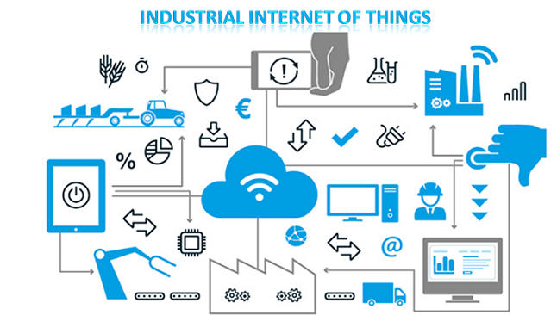
What is IIoT?
Source: Wildnet Technologies

Slide 22
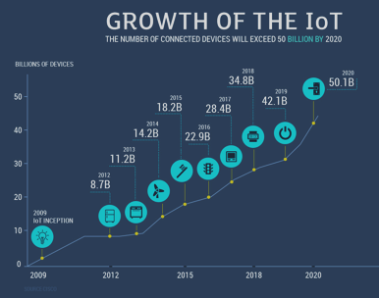
Industrial IoT (IIoT) will influence businesses in 2019
AI intelligence to edge analytics
Smart inventory forecasting & management
Smart production line monitoring
Plant safety & security
Packaging optimization
Quality control
Connected worker & wearable solutions
Smart fleet tracking
Energy consumption optimization
Logistics & supply chain optimization
Source: https://www.softwebsolutions.com/resources/industrial-IoT-in-2019.html
Notes:
2019 – Small and Medium Size Businesses adopting

Slide 23
Agenda
Introduction
Start with the End in Mind ‒ The Future of Packaging
2019 Trends and Predictions
What it Means for (Paperboard) Packaging
IIoT, Industry 4.0 Results
Key Takeaways

Slide 24

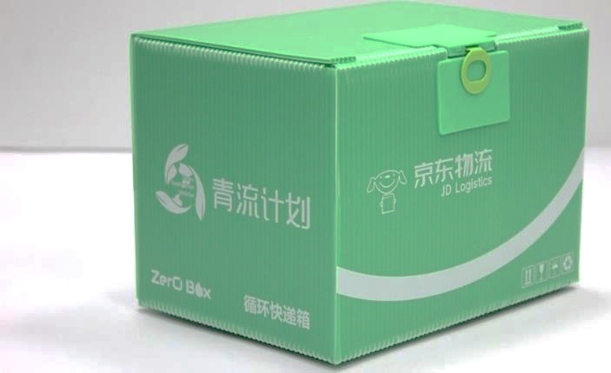
2019: What’s in Store for the Pulp and Paper Industry?
Rethink strategies and new business models to ride the tide of digital change
Intelligent packaging and personalization, driven by demand from e-commerce
Change the way manufacturing processes are automated ‒ digital technology in paper and pulp production
Increase production and precision ‒ digitize manual processes
High levels of manufacturing uniformity at lower energy production
Source: https://www.nordisktpapper.se/post/2019-whats-in-store-for-the-pulp-and-paper-industry
Notes:
https://www.nordisktpapper.se/post/2019-whats-in-store-for-the-pulp-and-paper-industry
To conclude, the paper and pulp industry will remain stable come 2019 provided that overall operating earnings are contained. There’s a nagging perception that with the continuous digital transformation of processes, paper is a dying product. On the contrary, the demand is strong with the increase in activities in ecommerce industries and other products that still need paper. After all, the industry will not go extinct as long as the major players will think of ways to innovate and disrupt within their sectors.

Slide 25
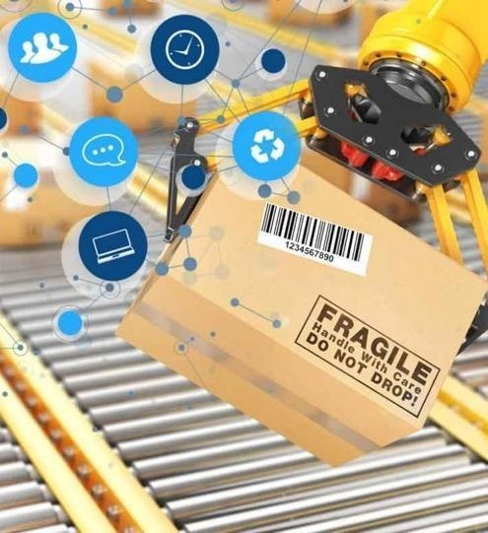
IIoT Continues to Transform Production and Packaging Lines
Manufacturers lose thousands of dollars to waste
…Unplanned line downtime, material waste, overproduction, quality-related losses, and poor use of capacity/assets
Insidious waste many managers are unaware of: inconsistent or inaccurate data
Finished-unit production numbers, length of downtime, line speed, and the number of rejected units all need to be monitored constantly and reliably ‒ and not just at the end of the shift ‒ if you really want results
Notes:
IIoT Continues to Transform Production and Packaging Lines

Slide 26
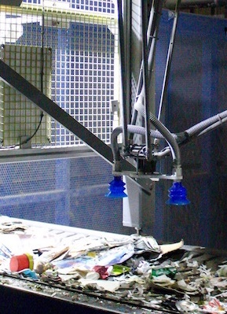
AI – Playing a Key Role in Packaging 2030
OPERATIONS
Vision inspection systems
Data labeling
E-commerce size/ packing optimization
Warehouse management/ ordering of robots
Machine uptime/ predictive maintenance
“End of Use” - Sorting recyclables
OFFICE/ R&D
Predictive sales/material management
Project planning/ management
Modeling – shelf life, line development
Enhanced experience (beyond QR codes to more personalized consumer interaction)
Data analytics
Source: www.cbinsights.com
Notes:
Much more of a role in being a support role. Actually if you look at most of these areas - AI wouldn’t be supplementing and supporting humans rather than replacing them. I certainly hope so!
Operations - https://www.pdachain.com/2018/08/02/ai-and-packaging-what-you-need-to-know/
E-commerce - https://www.forbes.com/sites/cognitiveworld/2018/08/05/4-powerful-ways-artificial-intelligence-is-molding-e-commerce/#abc13be4b113
https://www.sunbrandingsolutions.com/news-and-views/a-packaging-view-on-artificial-intelligence/
SIG and GE - http://www.eweek.com/innovation/how-ge-digital-is-using-ai-iot-to-upgrade-drink-packaging
- working on address the industry’s two biggest needs today: improving asset performance and optimizing service delivery.

Slide 27
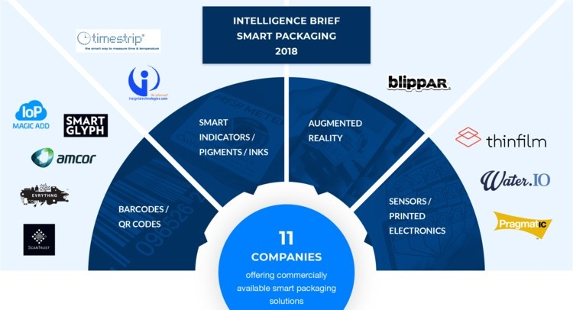
PreScouter identified 11 companies that are already offering commercially available solutions for smart packaging
Notes:
July 2018 Report - PreScouter was founded in 2010 in Evanston, IL by four Northwestern University graduate students (two MBAs and two PhDs). The idea for the company was sparked by a seemingly avoidable Tragedy in China and the struggles of a Northwestern alumnus – an R&D Director at a medical device company – in accessing university research.
Initially, the concept was to connect corporate R&D labs to research coming from academia. However, after completing pilot projects with Kraft Foods, UOP (Honeywell) and DSM, the founders realized that corporate leaders were more interested in a broader scope of services, one that included technology landscapes and in-depth investigations of relevant areas of interest, including innovative startups and emerging technologies. Most importantly though, clients were interested in the fresh perspective and unbiased, critical analysis provided by PreScouter’s talented teams of Advanced Degree Researchers (“Scholars”).
Over the past seven years, PreScouter has established a global network of aspiring and accomplished scientists, engineers, economists, analysts, and developers who share a common ambition: to apply their academic knowledge and problem-solving skills to challenges faced in industry. As the company has grown – having delivered over 1500 projects to more than 300 clients – this “Global Scholar Network” has also grown to include over 2000 Advanced Degree Researchers from five continents, representing the top research universities in the world.
In 2019, PreScouter continues to develop new ways to connect this network of brilliant minds with our clients around the world in order to share knowledge and help advance technology and innovation.

Slide 28
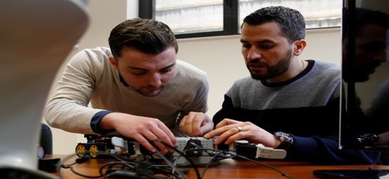
Future Skills
Siemens Foundation’s Middle-Skill Initiative, work with young adults to close the ‘opportunity gap’ and build careers in the fields of science, technology, engineering and math (STEM)
Year Up provides training, support and meaningful work experience to nearly 4,000 young adults annually, with the aim of helping them fulfill their potential in higher education or kick-start a career
Notes:
http://www.siemens-foundation.org/programs/stem-middle-skill-initiative/
https://www.yearup.org/our-approach/how-it-works/

Slide 29
Agenda
Introduction
Start with the End in Mind ‒ The Future of Packaging
2019 Trends and Predictions
What it Means for (Paperboard) Packaging
IIoT, Industry 4.0 Results
Key Takeaways

Slide 30
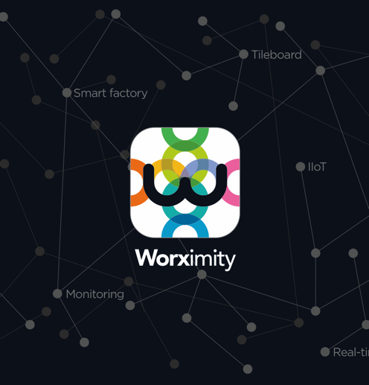
The Future – Agile IIoT Solutions
Worximity
Founded in 2012
Over 1,500 installations: US, Canada, France, Australia, Mexico
Notes:
Founded in 2012
Team of 25 employees
Investors : BDC, RBC, IQ, W and FTQ
Over 1,500 installations across the world: US, Canada, France, Australia, Mexico

Slide 31
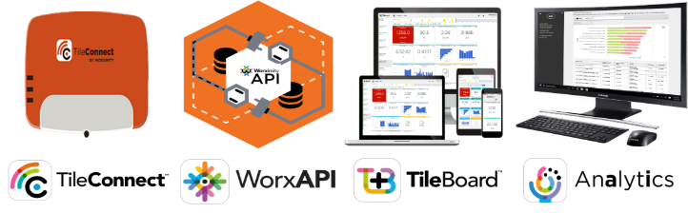
Simplifying Digitization
Machine installation in a matter of minutes, without servers or network wiring
Connect to your standardized API
Platform monitoring in real time, mobile and cloud
Pre-configured and scalable reporting platform focused on what’s important
The Worximity solution… Always simpler!!!
1
2
3
4

Slide 32
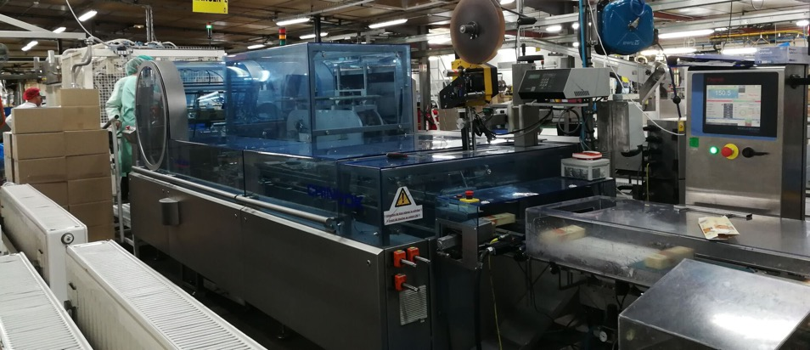

Worximity in a factory

Slide 33
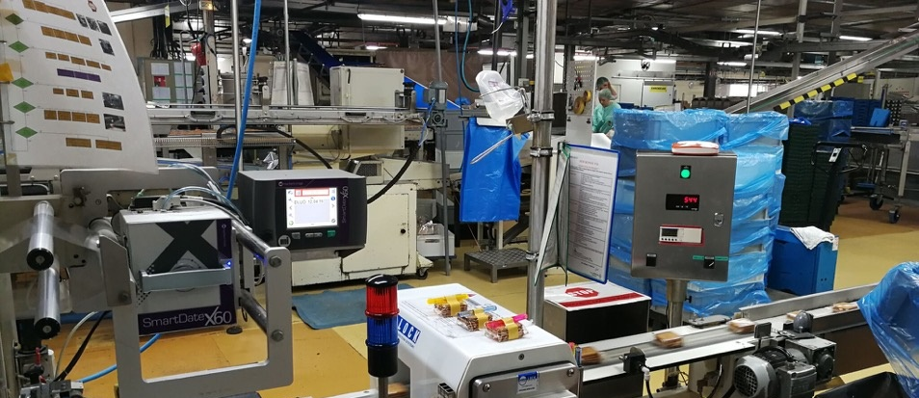

Worximity in a factory

Slide 34
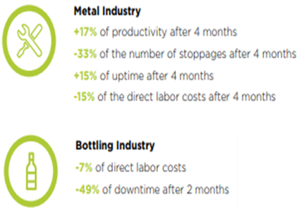
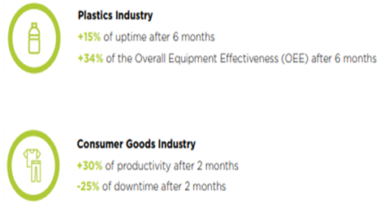
Agile smart factory floor solutions – step one in the digital transformation journey
Smart factory real time analytics turbo-charge lean manufacturing principles and drive increased machine uptime, labor savings and reduced total production hours resulting in significant manufacturing efficiencies and rapid ROI.

Slide 35
Agenda
Introduction
Start with the End in Mind ‒ The Future of Packaging
2019 Trends and Predictions
What it Means for (Paperboard) Packaging
IIoT, Industry 4.0 Results
Key Takeaways

Slide 36
If you only remember two things from my presentation, they should be…
No industry segment is immune to the change brought forth by IIoT, Industry 4.0
Look closely at existing business processes – it’s not about starting over – but it is about double digit results!
Early-adopters to IIoT will gain the competitive advantage

Slide 37
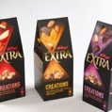


When you get back to your office, the two things you should do are…
Determine, on a scale of 1-10, how ready are you for the 4th Dimension?
Begin the journey today at whatever point you are starting from
You are not alone – identify collaboration partners to help get started!
Embrace foresight!
Images courtesy of PPC – exclusively for this presentation!!!

Slide 38

FOR ADDITIONAL INFORMATION:
PTIS
Brian Wagner brian@ptisglobal.com
(269) 806-4566
THANK YOU!
Notes:
I’d love to hear from you. Q&A

