Slide 1

2019 Spring Outlook & Strategies Conference
2019 Spring Outlook & Strategies Conference
MARKETING
COMMITTEE
UPDATE
Jeremy Keenan, Marketing Committee Chair

Slide 2
MARKETING UPDATES
Building a Foundation
What’s New
Looking Ahead

Slide 3
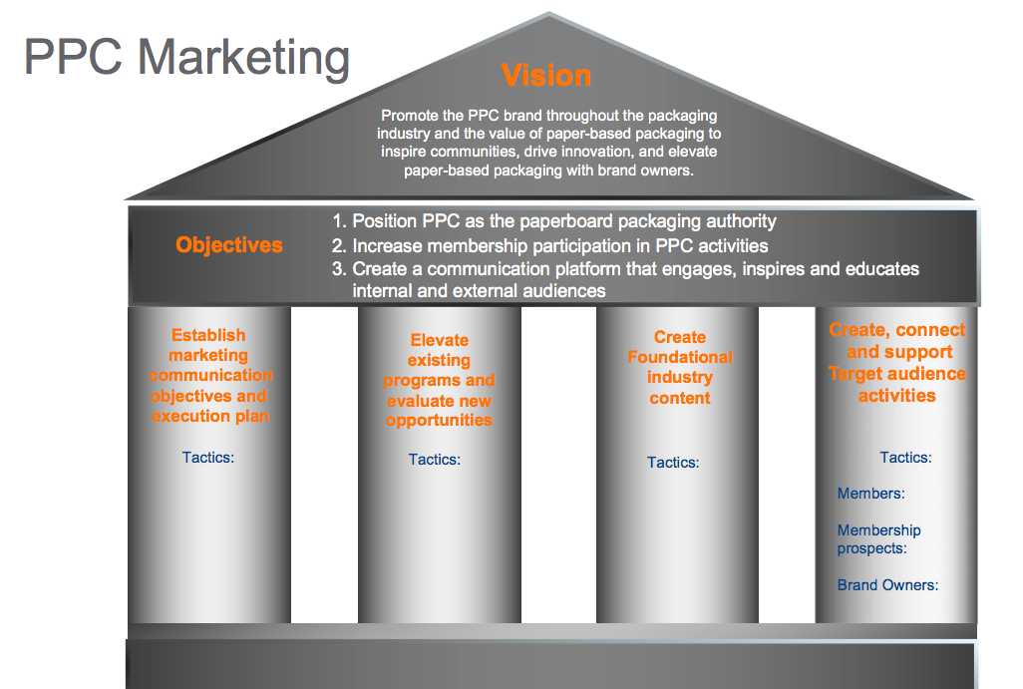
BUILDING A FOUNDATION
Fall Meeting Phoenix
Evaluated our Vision Statement
Established Objectives
Developed (4) Strategic Areas
Industry content
Elevate existing programs
Marketing communications
Engage target audiences

Slide 4
WHAT’S NEW
TICCIT
Carton Competition
New Logo
Re-designed Website

Slide 5
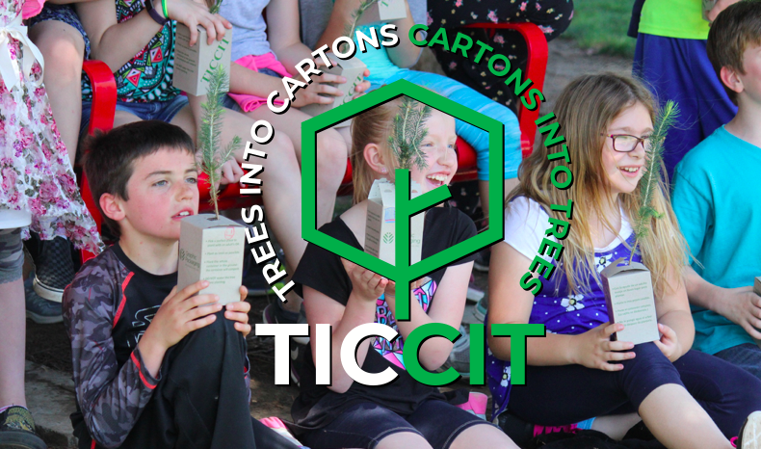

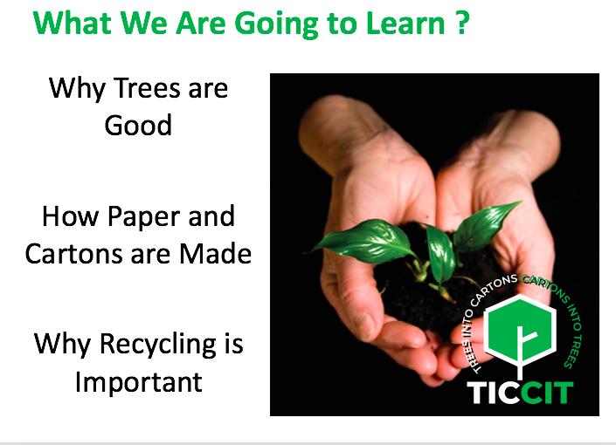
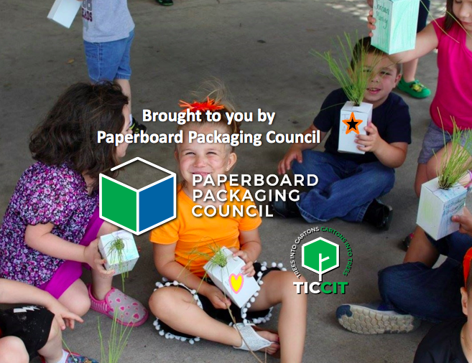

Slide 6
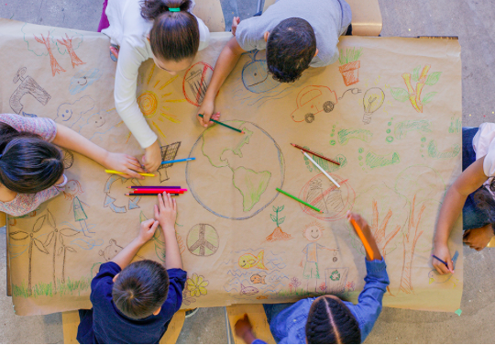
WHY IT’S IMPORTANT
Community Outreach
Telling the Story
Next Generation
Teaching kids about the environment and sustainability

Slide 7
RESULTS

Slide 8

76th NORTH AMERICAN PAPERBOARD PACKAGING COMPETITION
ENTRY SUBMISSION DEADLINE: JUNE 1, 2019

Slide 9
RESULTS

Slide 10
CARTON COMP
WHY IT’S IMPORTANT
Showcases industry leading innovation, creativity, and technical skill
Entering our 76th year- industry benchmark for packaging design
Recognition throughout the industry

Slide 11

NEW LOGO
Simple, Modern Design
Open edge showcases limitless creativity of our industry

Slide 12
RE-DESIGNED WEBSITE
Clean, fresh, contemporary, and conversational
Sense of authority and approachable
Sections lead into one another, driving engagement
Simple navigation to quickly find what you are looking for

Slide 13
paperbox.org

Slide 14
LOOKING AHEAD
We are the Voice of the Industry
TICCIT
Carton Comp
Look for new website in May

