Slide 1
Notes:
You can choose between 4 possible starter slides by going to the first slide on the left hand side, right click and then going on Layout

Slide 2
Company History
A combination of companies created to share knowledge and expertise for the paper industries
Barry-Wehmiller, acquires Marquip
Acquire Bielomatik Paper Processing
Acquire K&H and Questec
Acquire VortX
Acquire Curioni
2000
2007
2011
2015
2018
1968
2002
2008
2014
2017
Marquip, Inc founded in Phillips, WI USA
Ward Machinery Company, and United Container Co merge with Marquip to become MarquipWardUnited
Acquire Apollo
Acquire ECH Will, Pemco and Kugler-Womako and become BW Papersystems
Acquire Zerand

Slide 3











Cutting, converting, binding, corrugating, finishing, packaging, and box making
Cut-Size and Folio Sheeters & Packaging, Platen Die-Cutters
Corrugators and Finishing Equipment
RFID, Stationery, Passport
Machines, Banknote Sheeting & Converting

Slide 4
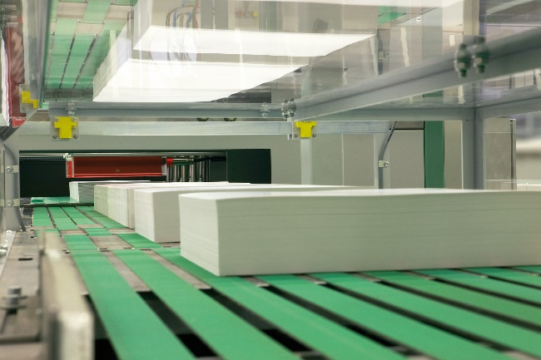
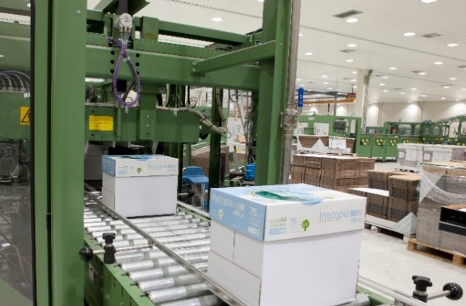


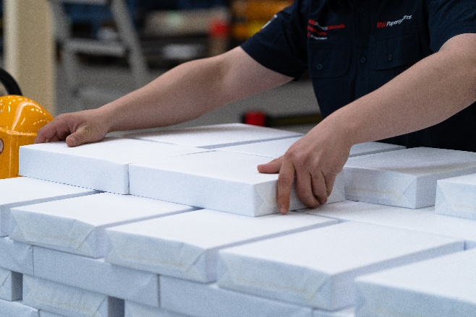
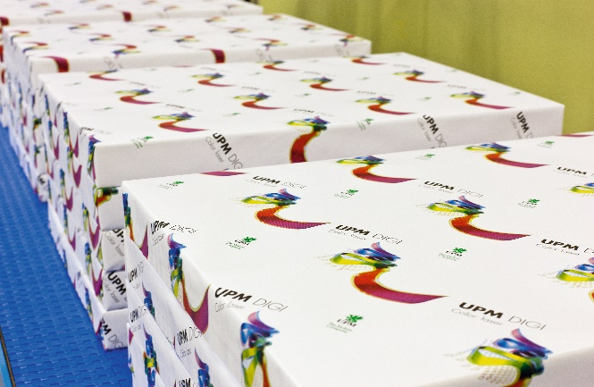
Digital and Cut-Size Sheeting & Packaging From the reel to the finished pallet, we offer solutions for cut-size converting, ream wrapping and packaging systems for the paper industry.
Brands
Locations
Hamburg, Germany
Sheboygan, WI (USA)

Slide 5
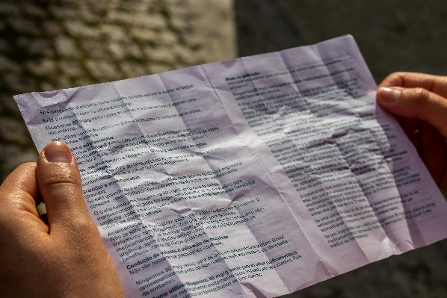
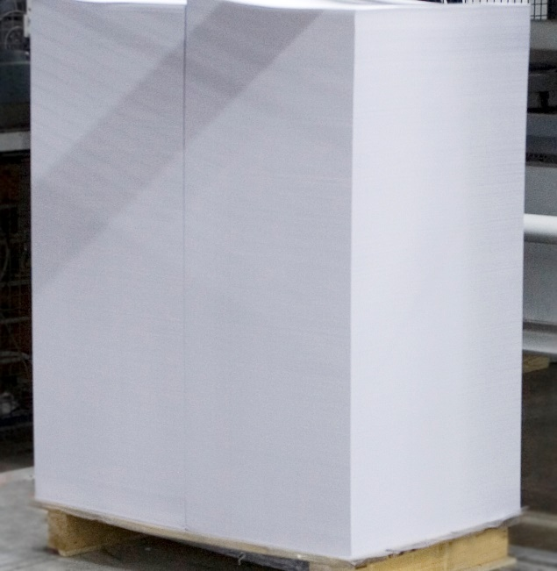



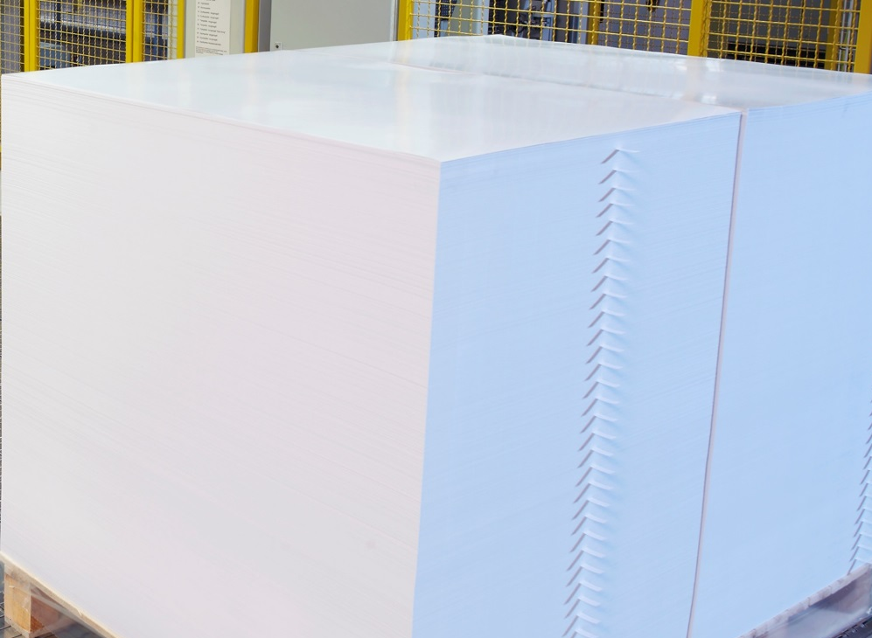

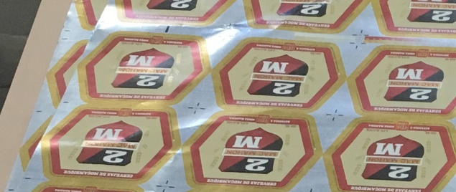
Folio-Size Sheeting Our folio sheeting systems provide the performance and product quality for the paper and board industry.
Brands
Locations
Phillips, WI (USA)
Sheboygan, WI
Hamburg, Germany

Slide 6
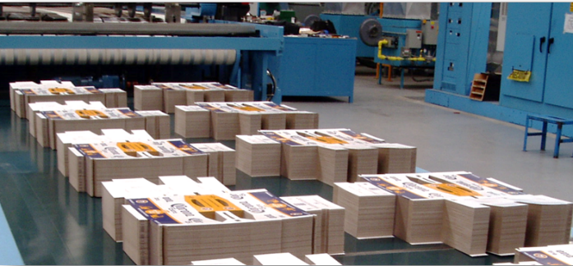
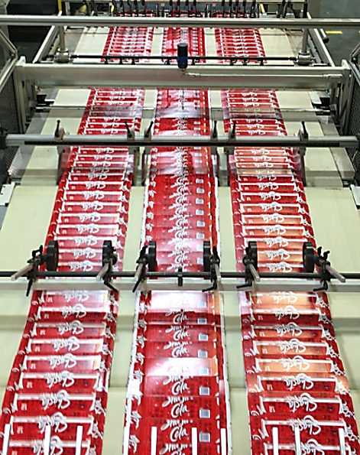

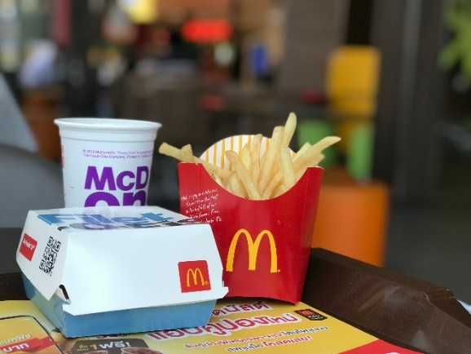
Folding Carton We are a global leader in web fed die cutting systems and solutions for the paperboard converting industry.
Brands
Locations
New Berlin, WI (USA)

Slide 7
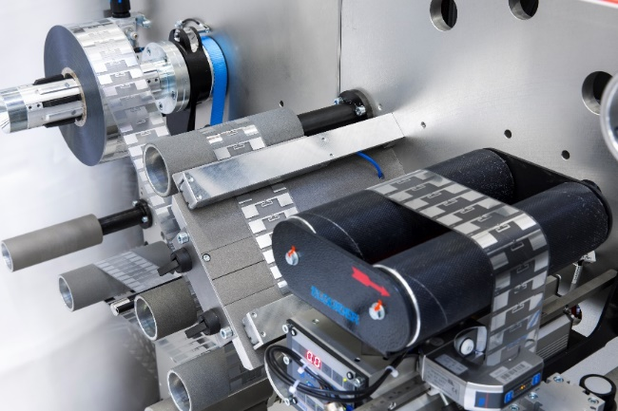


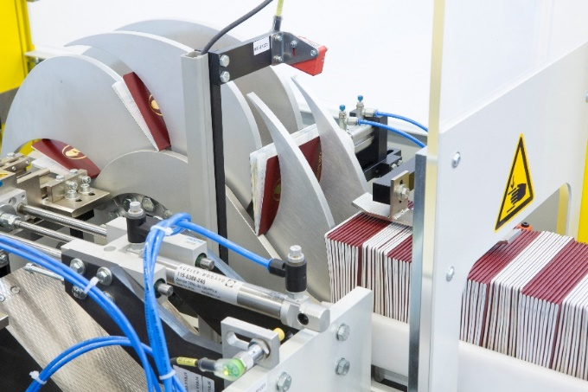

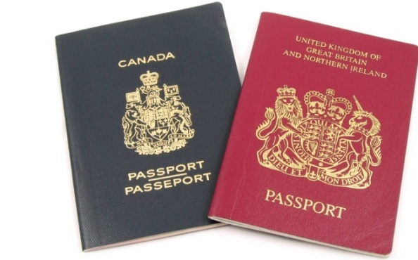
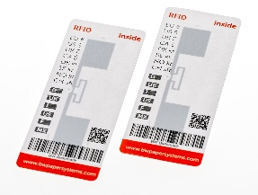
Security We offer manufacturing solutions for the production of Smart Labels and Tags, as well as passport finishing machinery and banknote sheeting & converting.
Brands
Locations
Stuttgart, Germany

Slide 8
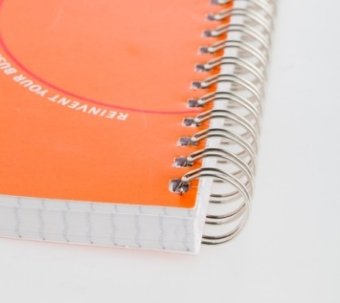
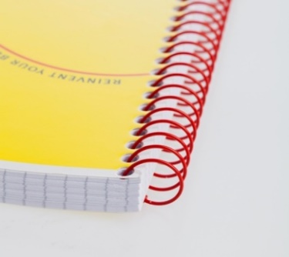
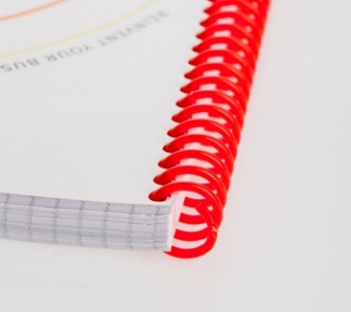
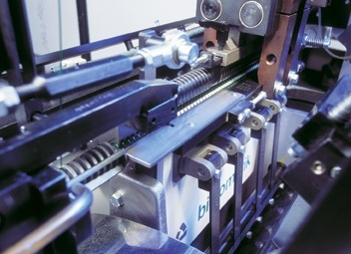
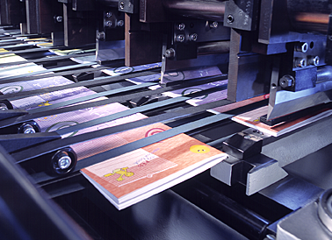
Stationery We offer a large variety of machines for the production of printed products and stationery.
Brands
Locations
Hamburg, Germany
Stuttgart, Germany

Slide 9

Service & Parts Support
We provide the best service for the global market
On-Line
Support via
Internet
Field
Service
Representatives
RESULTS
Quick
Delivery
Preventive Maintenance Programs
24/7/365
Technical Support
Quick
Quote
High Quality OEM Parts
Machine Audits
Notes:
The companies

Slide 10



Upgrades & TIPs
We have developed a wide variety of upgrades and Technical Improvement Programs to keep your equipment prepared for future production demands.
Obsolecence
Performance
Safety

Slide 11








Want to know more?
Find your local contact at
www.bwpapersystems.com
Follow us on Social Media

