Slide 1

Introduction
2020-04-29
Coty

Slide 2



Say it with us…
Introduction
222
Bill – uh– rood – coarsh – nass
We are Swedish “STOCK” and we’re “Glada” to call America our second “HOLM”

Slide 3

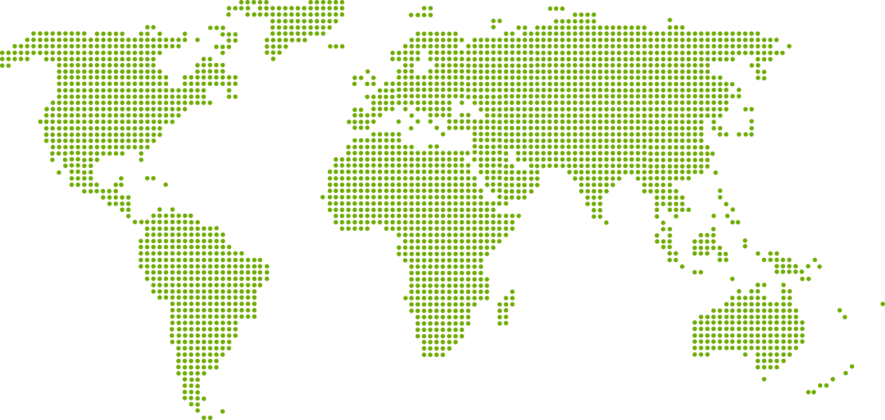


Evolving to embrace innovation
3 Divisions
Net Sales
A strong platform
for growth and
profitability
With a focus on
customer value,
innovation and
sustainability
Creating networks
with an open mind
$2.6
72%
17%
4%
2%
4%
8
Production units
54%
Board
Share of net sales
Billion
36%
Paper
Share of net sales
Beetham
Frövi
Rockhammar
Gruvön
Gävle
Karlsborg
Pietarsaari
Skärblacka
4%
Solutions
Share of net sales
4 500
Number of employees

Slide 4
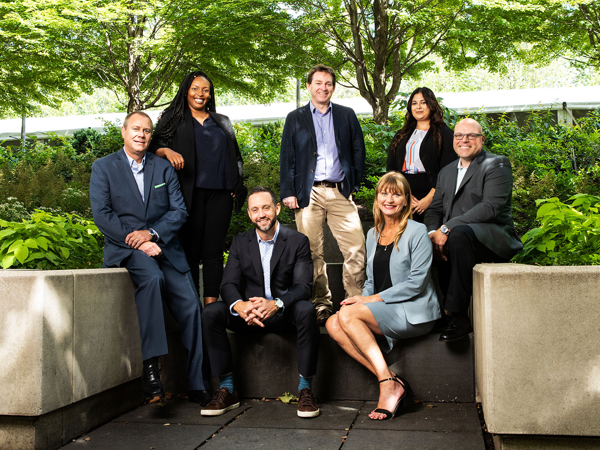
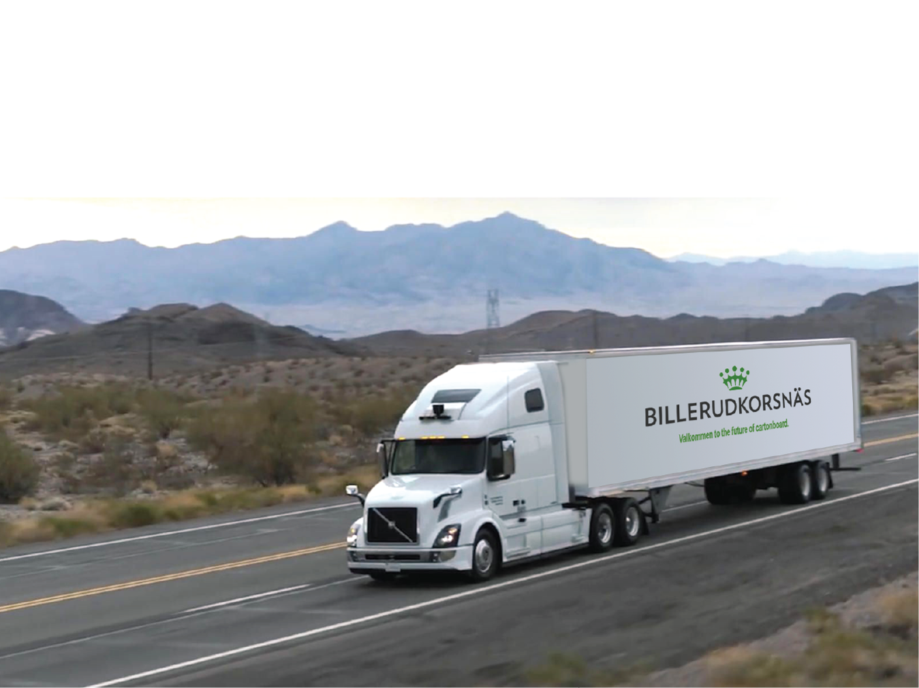
BillerudKorsnas USA
Packaging Papers, Miami
Managed Packaging, Portland
Cartonboard, Rosemont
  USA market share 20% of new Gruvon, Sweden plant
  On US ground since 2016
  4 months inventory of various weights and finishes available
  Standard sized rolls and sheets ship in 2 days
  Custom sizes ship within 5 days
  7 member team made up of brand and sales development, customer service and technical expertise

Slide 5

THE MOST SUSTAINABLE
PACKAGING COMPANY
ON EARTH
For some, sustainability is just another initiative.
For us Swedes, putting environmental stewardship
first in all we do is second nature.
5

Slide 6


#1 on the Dow Jones Sustainability Index for the packaging industry
BillerudKorsnäs is included in Dow Jones Sustainability Index
Sustainability leader for Containers & Packaging
  Top 10% across all industries
Industry top scores for our climate strategy, customer relationship management, supply chain management and talent attraction & retention.
Notes:
Included in Europe index 2017 and World index (top 10%) 2018 and 2019
Sustainability Leader and best score in Containers & Packaging in Europe and the World - all dimensions (economic, environmental, social)
Top scores
Economic – Risk & Crisis Mangemnet
Environmental – Climate strategy, Environmental reporting, Water related risks
Social – Labor practice indicators, Social reporting, Talent attraction & retention
63% higher score than the world´s Containers & packaging industry average

Slide 7
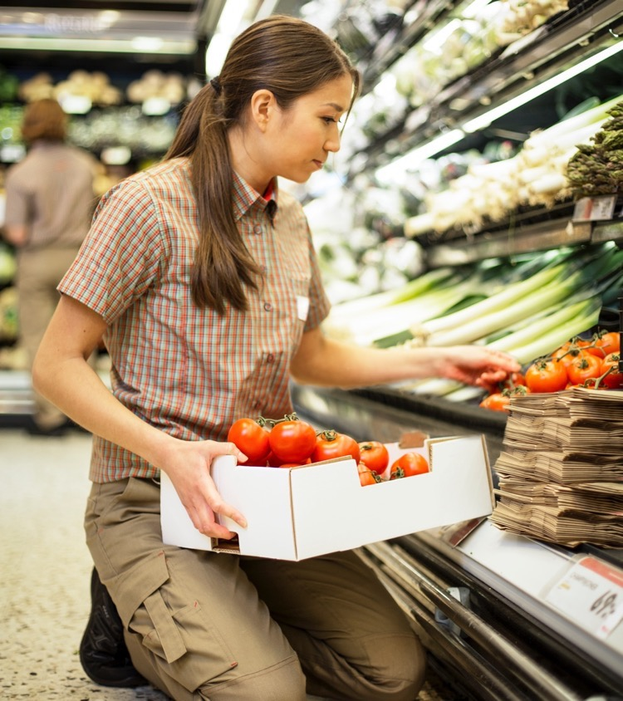
Towards a
bio-based society
At BillerudKorsnäs, we have
a long-term commitment to
combat climate change
Notes:
To apply a positive influence, BillerudKorsnäs works closely with companies and other organisations at
a local and global level. Collaboration of this kind is crucial for achieving a sustainable future, where more emphasis than today is placed on the potential of renewable material.
By working together, it is possible to create both social and environmental societal value

Slide 8


Our vision is to phase out fossil fuels
sustainability
8
In 2019 we used 96.8% biofuels
and only 3.2% fossil fuels
Notes:
BillerudKorsnäs has a stated climate strategy and our vision is to phase out fossil fuels completely from our own production processes. Renewable bioenergy accounts for around 97 per cent of the fuel we use today. We are also working to reduce emissions of fossil CO₂ in our production processes, and one of our stated sustainability goals is Fossil-free production.
http://billerudkorsnas.com/Sustainability/Towards-a-sustainable-and-bio-based-society/Our-climate-work/
8

Slide 9
C02 Emissions Comparison
North American Mill:
Cartonboard Production = 300 - 600kg of CO2 per metric ton (average= 450kg)
+
Transportation (truck) = .08kg of CO2 per metric ton / kilometer
(Baltimore, MD to Toronto, ON = 737km = 59kg)
______________________
= 509kg of CO2 per metric ton (1,122 pounds / metric ton)
BillerudKorsnäs Mill: Cartonboard Production = 30kg of CO2 per metric ton
+
Transportation (truck) = .08kg of CO2 per metric ton / kilometer
(Baltimore, MD to Toronto, ON = 737km = 59kg)
+
Transportation (ocean) = .025kg of CO2 (average) per metric ton / kilometer
(6,327km from Gothenburg, Sweden to Baltimore, MD = total of 158kg)
______________________
= 247kg of CO2 per metric ton (544 pounds / metric ton)

Slide 10
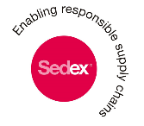





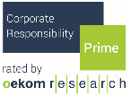

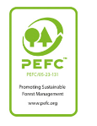
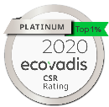



Sustainability credentials
Billerudkorsnäs CORPORATE - sustainability
10
Transparency reporting and labels
CDP CLIMATE
CDP FORESTS
CDP WATER
PULP
ADVANCED LEVEL
Notes:
10

Slide 11
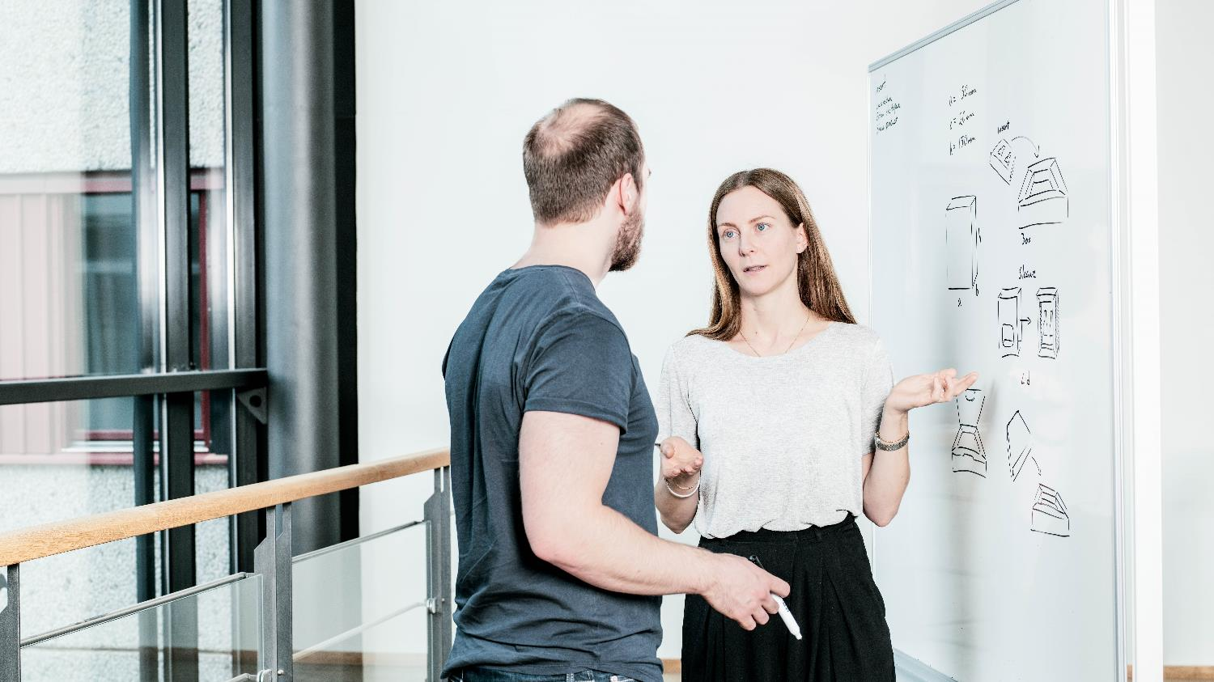
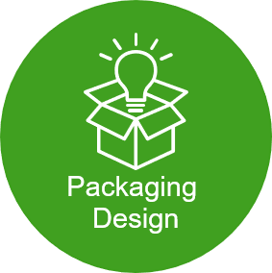


Carton Solutions Services
Billerudkorsnäs CARTONBOARD – VALUE PROPOSAL – Carton Solutions
11
The team of Carton Solutions consists of a mix of people with different backgrounds and expertise.
The common factor is that we all great packaging!

Slide 12
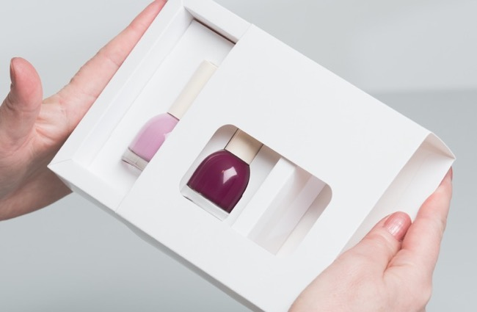
Starting with your needs and requirements
It begins here: New design for new product or revamp existing
packaging – improve, optimize, rebrand …
Better protection of contents
User-friendliness, function
Shelf impact
Environmental performance
Lightweighting = cost reduction
Improved logistics solution
Technology integration
Notes:
It begins here: Your need for a new packaging concept. A product launch. Or a revitalization of your shelf presence. A need for innovation or optimization. The whole or single specific aspects.
Better protection, more user friendly, higher shelf impact, less waste, better environmental performance, improved function, lower cost, reduced packaging weight.
Integration of NFC, bar codes, QR codes and tamper-proofing techniques.

Slide 13
Packaging Innovation Library
Structural Innovation Examples

Slide 14
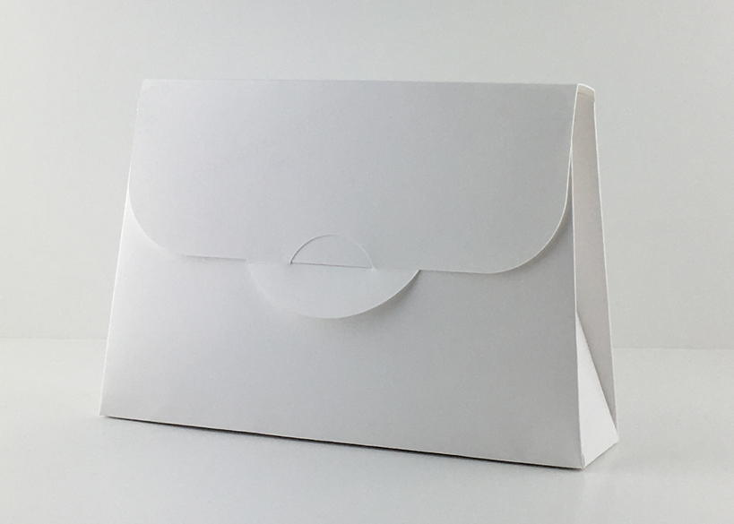
Gift set pouch

Slide 15
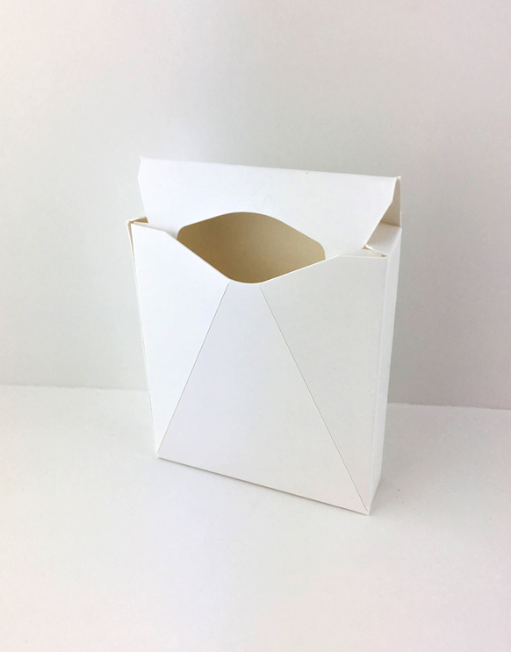
Top load gift pouch

Slide 16
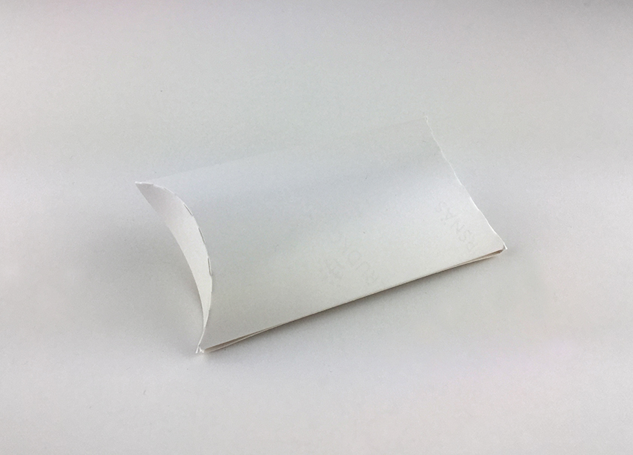
Side dispensing envelope package (could work for cosmetics)

Slide 17
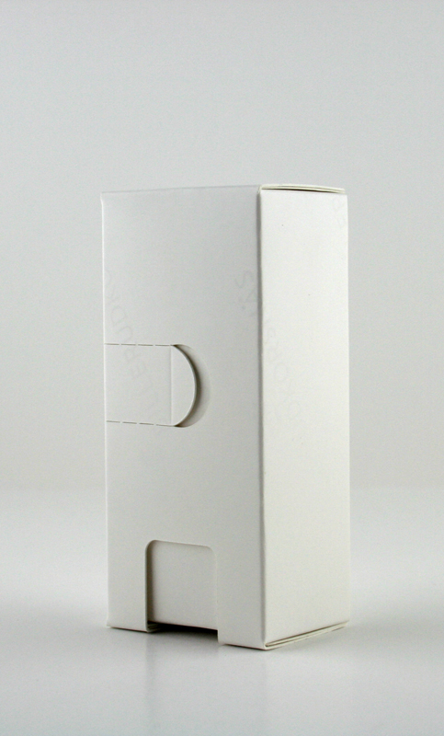
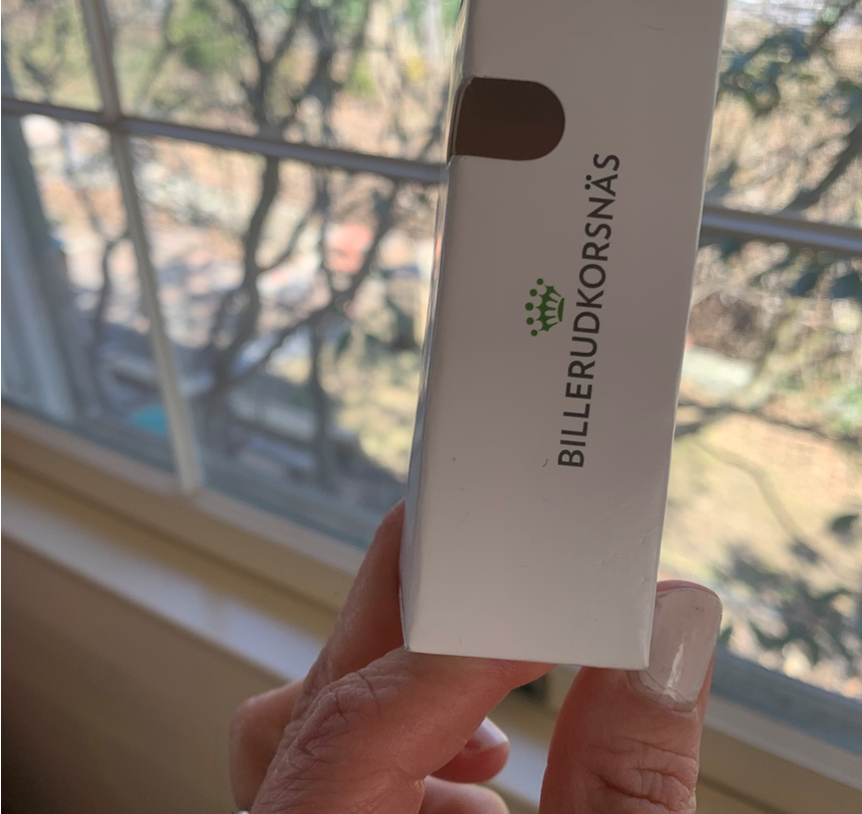
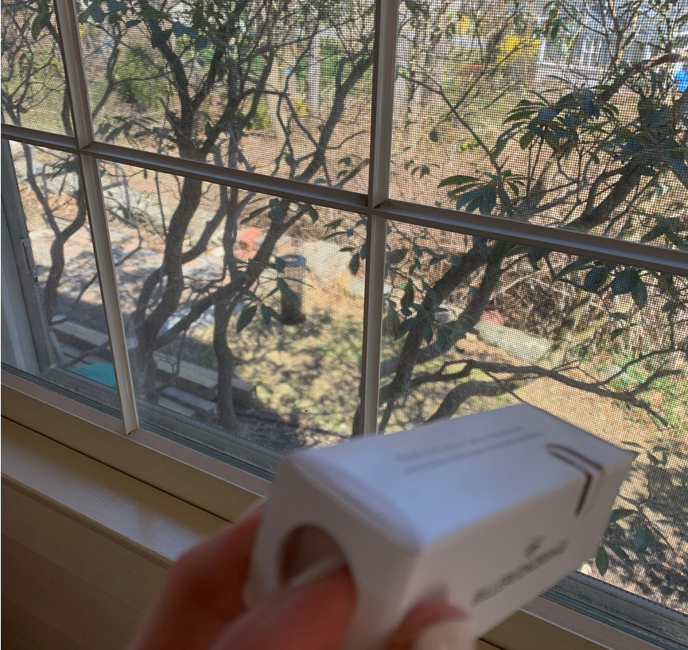
Dispensing package
Notes:
EU brand, won structural packaging awards
Single material construction

Slide 18
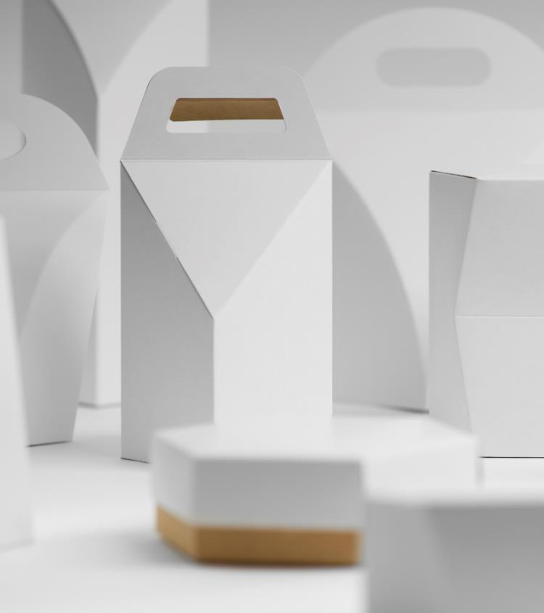
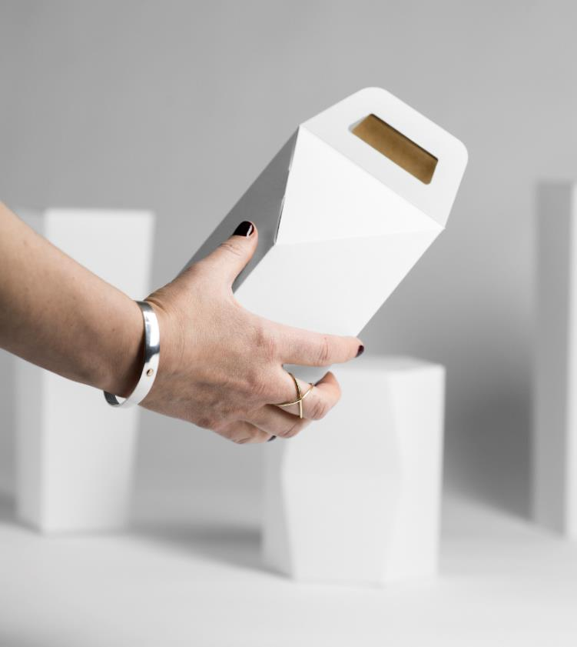
Product portfolio
VALUE PROPOSAL - Materials
18

Slide 19
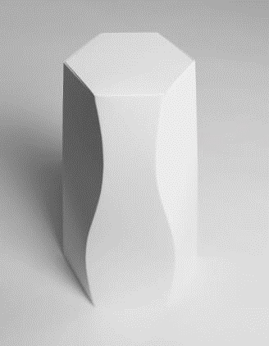
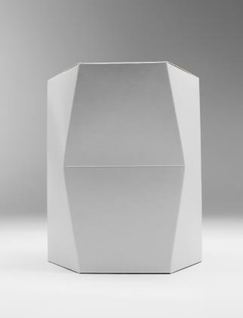
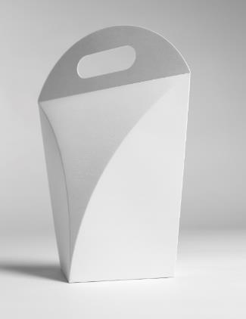

CrownBoard Product Portfolio
VALUE PROPOSAL - Materials
19
CrownBoard Prestige™
CrownBoard Craft™
CrownBoard Artisan™
Sophistication in a box
Probably the strongest cartonboard in the world
Take advantage of the touch-and-feel dimension

Slide 20
CrownBoard Product Portfolio
VALUE PROPOSAL - Materials
20
CrownBoard Prestige™
CrownBoard Craft™
CrownBoard Artisan™
CrownBoard Prestige offers superior printability, primarily thanks to the coating formula and the high whiteness.
The combination of a strong but flexible board with excellent visual appearance is beneficial for demanding premium brands.
CrownBoard Craft is a natural brown back board. Its strong and tough, a heritage from the high quality raw material sourced in the Swedish forests.
The strength in CrownBoard Craft offers a potential for packaging weight reduction.
CrownBoard Artisan talks to the senses. The special silky-smooth surface adds an interesting touch-and-feel dimension to a package.
Soft to the touch, but strong and sturdy, it offers excellent packaging performance and lightweighting opportunities.

Slide 21
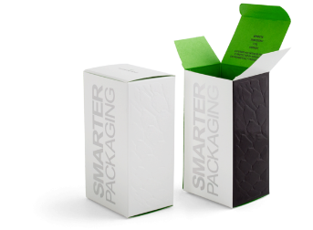
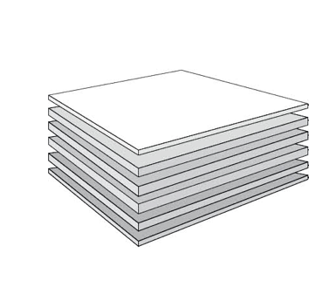


Billerudkorsnäs CrownBoard Prestige
What’s different….
220, 235, 265, 290, 315, 340, 370, 400 gsm
11.24 12.0, 14.0, 15.9, 17.95, 19.9, 21.9, 23.8 caliper
Most modern board manufacturing technology.
We are Stronger. On average 20% stronger than domestic SBS.
We are Stiffer & more Tear Resistant than domestic SBS.
We are Lighter. On average 8% lighter at same caliper than domestic SBS.
TRIPLE CLAY COATING
BLEACHED CHEMICAL PULP
BCTMP MIXED WITH BLEACHED CHEMICAL PULP
BCTMP MIXED WITH BLEACHED CHEMICAL PULP
BLEACHED CHEMICAL PULP
LIGHT COATING
Notes:
Artisan and Prestige also available

Slide 22


CrownBoard Prestige
Structural and design benefits
MATERIALS
Excellent formability and outstanding print surface
Crack resistant
Exceptional surface for embossing and hot foil stamping
High yield enabling lightweighting opportunities
Highest purity – excellent taint and odour properties
Highly versatile material, made of 100% primary fibres
FULLY COATED TOP SIDE, LIGHT-COATED REVERSE SIDE
MULTIPLE LAYERS
100 % PRIMARY FIBRE
Notes:
MULTIPLE LAYERS
• Fully coated – clay coating
• Bleached chemical pulp
• BCTMP mixed with bleached chemical pulp
• BCTMP mixed with bleached chemical pulp
• Bleached chemical pulp
• Light clay coating on reverse side

Slide 23
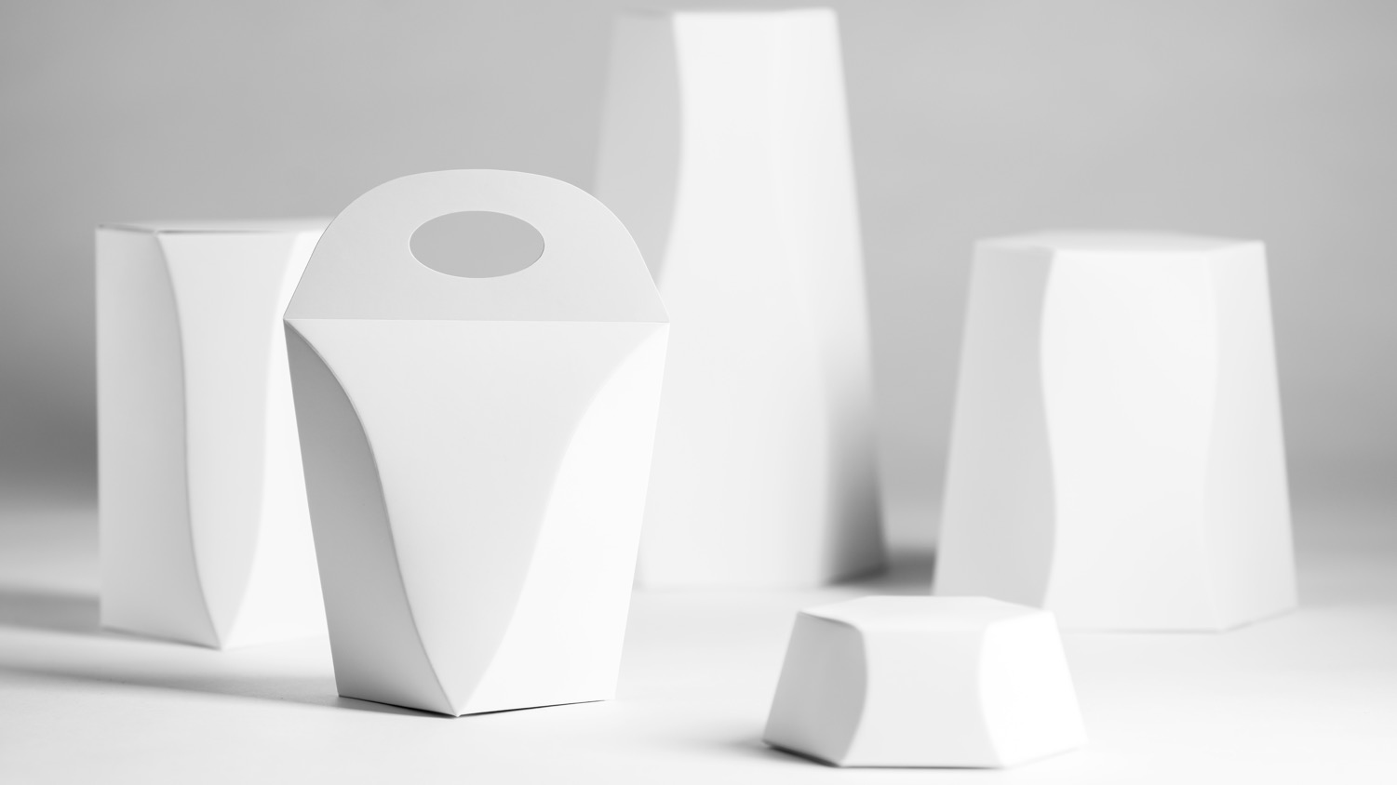
CrownBoard Prestige
MATERIALS
Product range
Grammages: 170 200 220 235 265 290 315 340 370 400 gsm
Caliper microns: 205 255 290 305 355 405 455 505 555 605 µm
Caliper points: 8.1* 10.0* 11.4 12.0 14.0 15.9 17.9 19.9 21.9 23.8 pt
*Available Q3 2020
Notes:
Note: All specifications may be subject to change – always check with the latest technical specification sheets on the Billerudkorsnäs web site.

Slide 24
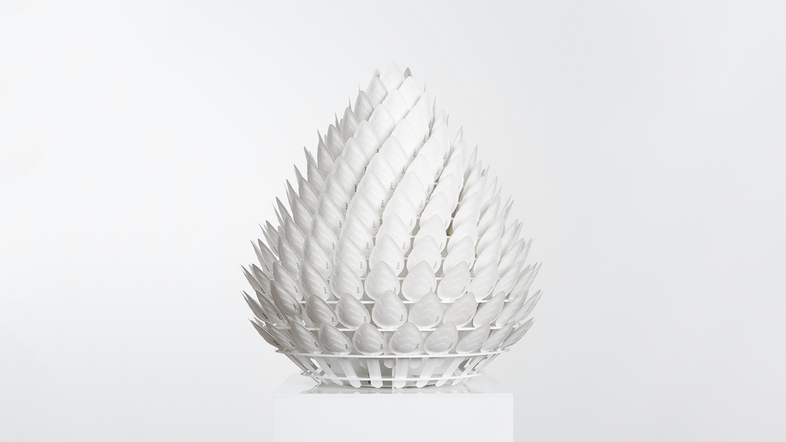

What if Innovation Made the Difference
Notes:
Innovation has always been a key factor for BillerudKorsnäs.
Rooted in ongoing research and everyday development, we turn great ideas
into new materials and solutions. And, it’s not just about creativity, it is hard work and capability to execute.
---
(You will find more material slides in the appendix and also in the separate ”Innovation presentation”.)

Slide 25
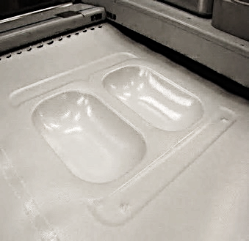
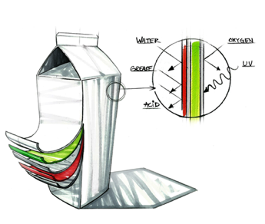
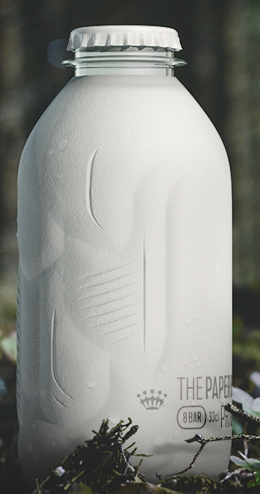
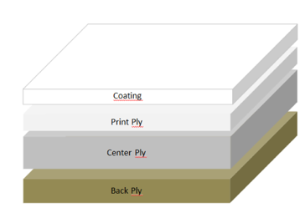
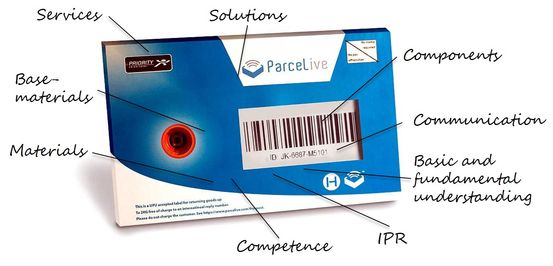
Flagship projects – key features
Cartonboard
structure
Recyclable Flow-wrap
Plastic deformation
Stiffness
Convertibility
Thermoformable
MFC Boost
Lighter
Stronger
Bulkier center ply
Barriers
In-mill applications
Integrated within packaging material
Bio based
Bio degradable
Paper Battery
Conductive materials
Energy storage
Sensors
Paper Bottle
Paboco
Notes:
We today have 3 eastablished ”technology platforms as a foundation for our advanced material research. We are currently looking into adding on or a few new platforms. That is why the fourth platform here is a mix of various functionalities and features. The terminology ”technology platform” might be changed to research area or something along those lines later on in 2018 but at the moment this terminology can be used. And the plastic straw – our committment to support the removal of plastic straws in Sweden by 2021 has enabled us opportunity to work with Tetra pack to develop a single use paper straw.

